Slide 1


Migration & Assessment Report
FPT Software Hanoi (FHN)
Digital Transformation Global
April 26, 2022

Slide 2

1
EXECUTIVE SUMMARY
2
INFRASTRUCTURE ASSESSMENT
CONTENT
3
APPLICATION ASSESSMENT
4
TRANSFORMATION RECOMMENDATIONS
5
APPENDIX
© Copyright FPT Software – Level of Confidentiality

Slide 3
PROJECT BACKGROUND
ABC is , High Tech is seeking a long-term Strategic Partner that can help drive Cloud Transformation that match the company’s roadmap in order to:
Discover all workloads (Infra, App) in the distributed systems in data centers
Evaluate the opportunity to transform workloads to Microsoft Azure
Migrate and modernize relevant workloads to Microsoft Azure
Estimate the high-level TCO to prepare budget for Cloud Transformation program

Slide 4
PROJECT SCOPE
Assessment Workstreams
Cloud Transformation
Data/ App/ Infra (Solution, Reporting)
Project’s Deliverables
on/Data/Infra Inventories
Build Application/Data/Infra Inventories
Design Landing Zone & System Landscape on Cloud
Initialize Cloud Transformation Roadmap
Provide a High-level TCO of the System on Azure
Identify Possible Transformation Workload Strategy (opportunity to transform workloads
to Cloud using Re-host, Refactor, Re-architect, Rebuild or Replace approach)
1
2
3
4
5

Slide 5
Clarifying Motivations of PIACOM
Migration Learning:
The team plans to learn the following approaches
Shift & Lift
Modernization
Objective Focus:
TTTT= The team focuses on the following objectives
Assets
(infra, apps, & data)
Workloads
Critical Business & Motivations:
Prioritize the following motivations based on desired business outcomes
Data center exit
Reductions in capital expenses
End of support for mission critical technologies
Regulatory compliance, data sovereignty requirements
Reduce disruptions and improve IT stability
6. Cost Savings
Reduction in vendor or technical complexity
Optimization of internal operations
Increase business agility
Prepare for new technical capabilities
Scale to meet market demands
Scale to meet geographic demands
13. Build new technical capabilities
Improve customer experiences / engagements
Transform products or services
Disrupt the market with new products or services

Slide 6

1. EXECUTIVE SUMMARY

Slide 7
Executive Summary
Scope of the assessment:
56 systems assessed
Azure Ready 41 VMs
39 Windows
2 Linux
Ignored Machines
15 VMs
4 Applications
3 Web Form (Java 1, .Net 2) (Tool)
1 IoT System (Manual)
3 Databases
1 PostgreSql
2 MSSQL
Method:
Deployed Azure Migrate, App CloudPilot
Resource consumption data collected from CPU, RAM, Storage and I/OPS Utilization
Data collected by Azure Migrate was proceeded through CloudRecon to generate economic analysis.
Data collected by App CloudPilot was proceeded through CloudPilot to generate economic analysis.
Critical Key Findings
Remediate Windows Servers which are no longer supported or at the end of Extended Support.
Plan for Windows Server 2012, 2008 upcoming end of life events.

Slide 8
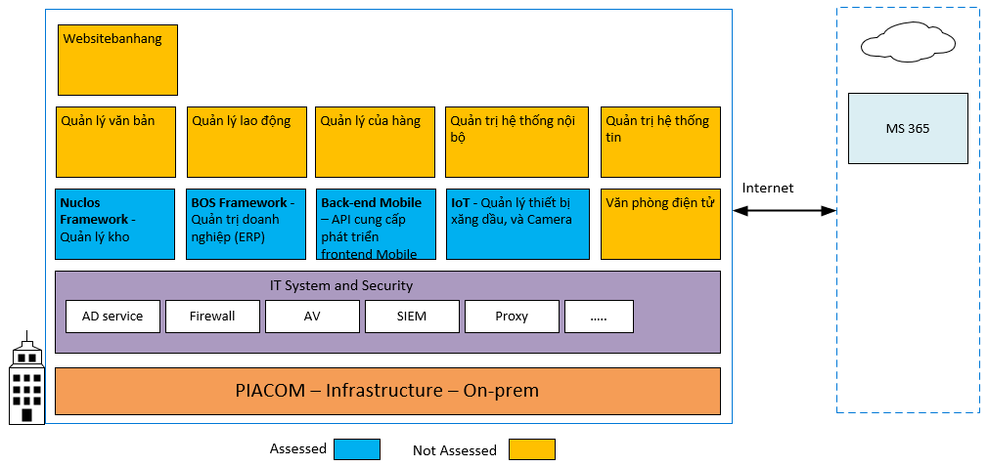
IT landscape

Slide 9
2. INFRASTRUCTURE ASSESSMENT

Slide 10
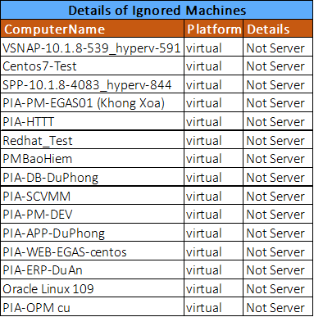
Performance & Utilization
Assessment: 56 Machines
Assessed Servers: 39 Windows, 2 Linux,
15 Ignored Machines
Total: 254 core, 687 Ram(GB), 13,88TB
37,48%
Average CPU
40,25%
Average RAM
98,68%
Average Storage
Resource Consumption
Virtualization platform | Hyper-V
Operating System | Windows Server 2019
Operating System | Windows Server 2016
 | Windows Server 2012
 | Windows Server 2008
 | Ubuntu
 | CentOS
Database | MS SQL
 | PostGre, Oracle

Slide 11
Windows Server - No Longer Supported
No. | ComputerName | IP | Application Name (Description detail) | CurrentOperatingSystem | Used_Storage(GB) | CPU | RAM
1 | PIA-PLCND | 10.59.254.30 | APP PAC_ERP_PRO | Windows Server 2008R2 | 130 | 4 | 8
2 | PIA-QLVB-WIN2008 | 10.59.254.4 |  | Windows Server 2008R2 | 70 | 1 | 4
3 | QLLD_APP | 10.59.2.6 |  | Windows Server 2008R2 | 80 | 4 | 16
4 | QLLD_DATA | 10.59.254.6 |  | Windows Server 2008R2 | 200 | 4 | 16
5 | PIA-PLCND02 | 10.59.2.22 | DB PAC_ERP_PRO | Windows Server 2008R2 | 140 | 4 | 16
6 | PIA-QLCH-TEC02 | 10.59.254.24 |  | Windows Server 2008R2 | 150 | 2 | 4
7 | PIA-QLCH-TEC | 10.59.254.10 | APP+DB support center | Windows Server 2008R2 | 130 | 2 | 8
8 | PIA-ERP-2008R2 | 10.59.254.18 |  | Windows Server 2008R2 | 900 | 2 | 32
9 | PIA-QTHT | 10.59.254.112 |  | Windows Server 2012R2 | 80 | 2 | 3
10 | PIA-HTTT | 10.59.254.114 |  | Windows Server 2008R2 | 100 | 1 | 8
11 | PM-APP | 10.59.254.108 | APP+DB PLL_EGAS_PRO | Windows Server 2008R2 | 200 | 4 | 16
12 | PIA-FRI | 10.59.254.105 |  | Windows Server 2008R2 | 130 | 2 | 6
13 | PIA-PM-DEV | 10.59.254.102 |  | Windows Server 2008R2 | 200 | 8 | 16
14 | PIA-PM-DEV02 | 10.59.254.103 | DB NXH_EGAS_TRN DB PLX_CLIENT_EGAS_UAT DB HAILINH_KHO_DEV DB PJCDN_EGAS_DEV DB PLX_CLIENT_DEV DB SUPPORT_CENTER_DEV DB NXH_EGAS_DEV | Windows Server 2008R2 | 300 | 4
15 | PM-DB | 10.59.254.107 | DB HOAKHANH_EGAS_PRO DB NXH_EGAS_PRO DB PETAJICODN_EGAS_PRO DB PJC_WebService_PRO DB PLL_EGAS_PRO | Windows Server 2008R2 | 500 | 4 | 32
16 | PIA-APP-EGAS | 10.59.254.110 | APP HOAKHANH_EGAS_PRO APP NXH_EGAS_PRO APP PJC_WebService_PRO | Windows Server 2008R2 | 200 | 1 | 8
17 | PIA-PM-DuAn | 10.59.254.111 | NHATMINH_HQ_PRO PETAJICODN_EGAS_PRO PETAJICODN_ERP_PRO | Windows Server 2012R2 | 100 | 2 | 16
18 | PIA-QTHT | 10.59.254.112 |  | Windows Server 2012R2 | 80 | 2 | 3
19 | PIA-PM-TEST01 | 10.59.254.33 |  | Windows Server 2012R2 | 320 | 4 | 8
20 | PIA-EGASERP-DB | 10.59.254.34 | DB CHAUTHANH_ERP_PRO DB PETAJICODN_ERP_PRO | Windows Server 2012R2 | 300 | 4 | 12

Slide 12
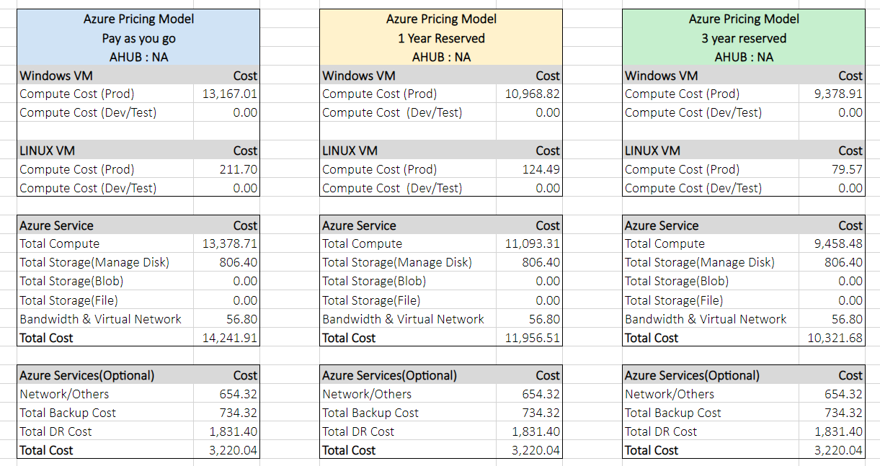
Current Environment | Lift and Shift ( As Is Configuration)

Slide 13
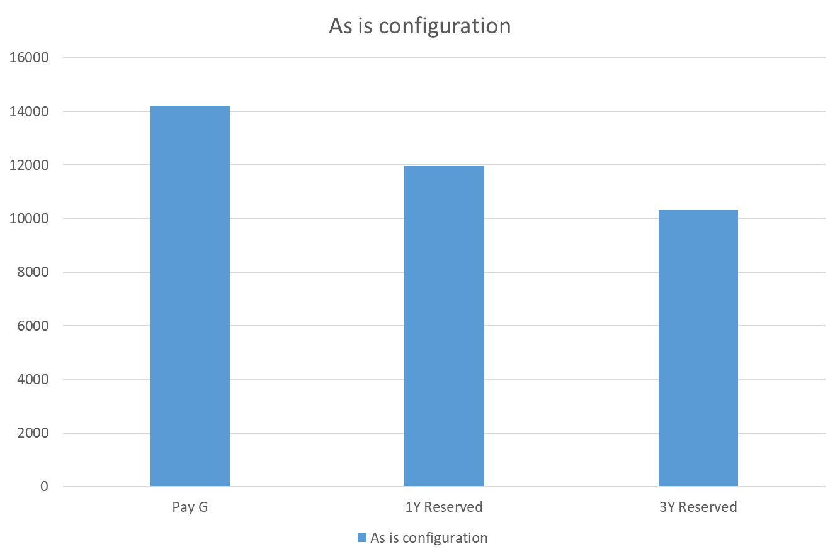
Current Environment | As is configuration Monthly Cost Comparison
Machine Type | Servers | PAY G | 1Y Reserved | 3Y Reserved
VMs | 41 | 14241.91 | 11956.51 | 10321.68

Slide 14
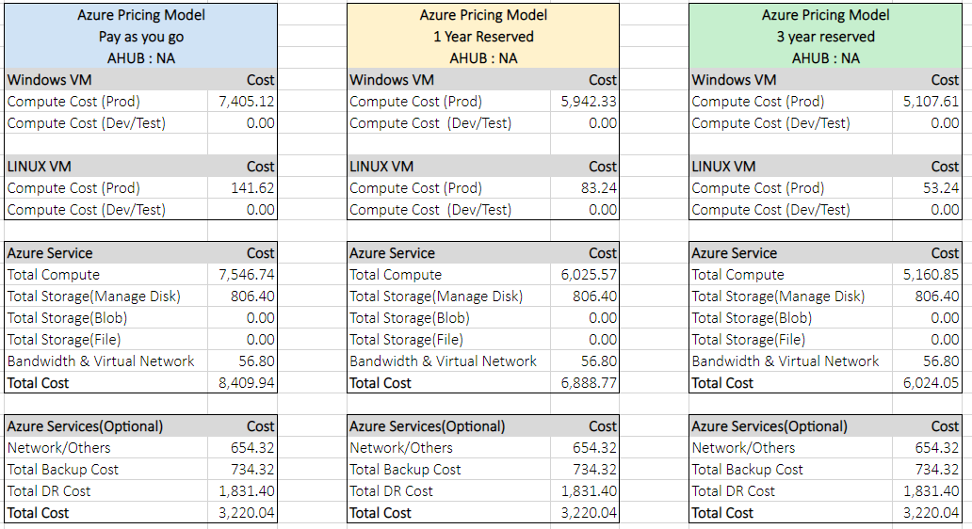
Current Environment on Azure | Optimized IaaS (Right Sized)

Slide 15
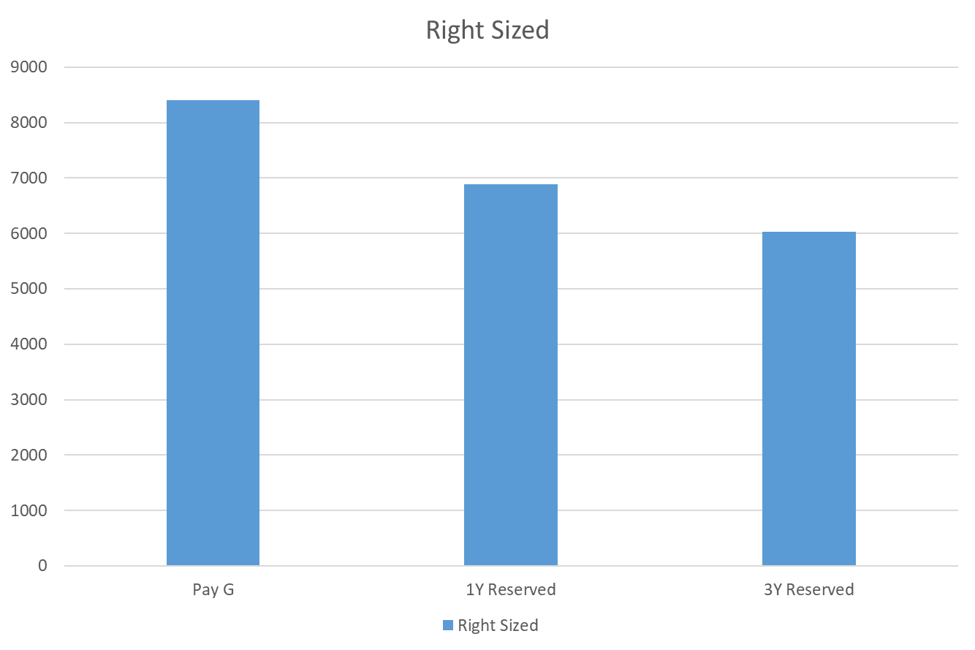
Current Environment | Optimized IaaS Monthly Cost Comparison
Machine Type | Servers | PAY G | 1Y Reserved | 3Y Reserved
VMs | 41 | 8409.94 | 6888.77 | 6024.05

Slide 16
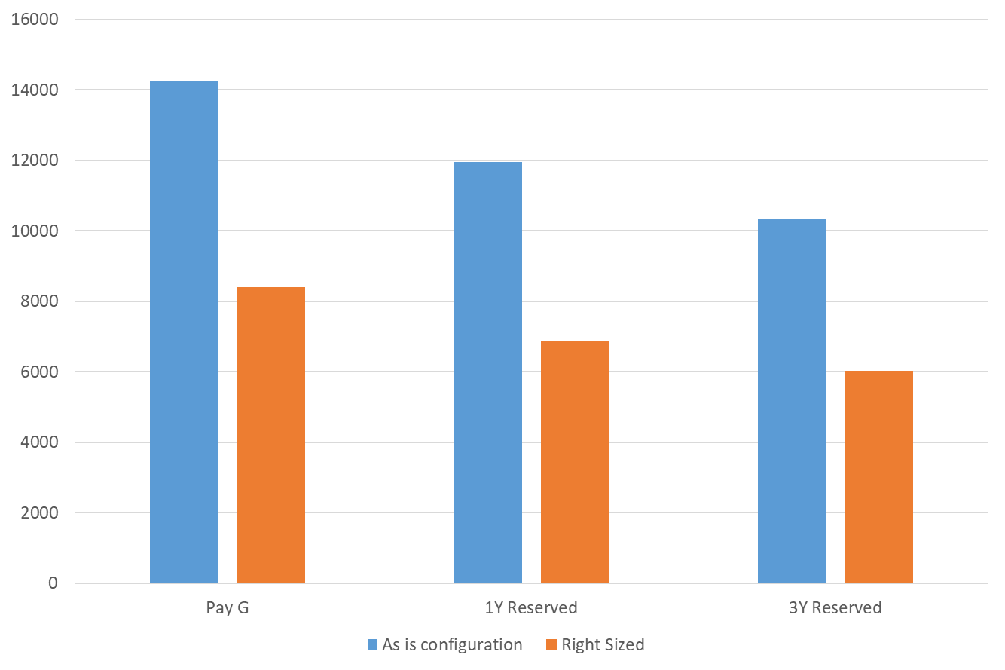
Business Case | IaaS (As is Configuration vs Right Sized)

Slide 17
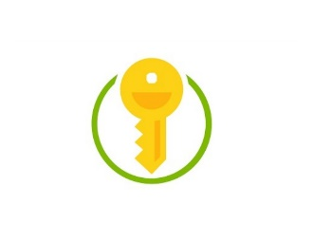











Current Environment on Azure | Azure Landing Zone Cost Outline
Key Vault
Application Gateway
Bandwidth
Network Watcher
Total Monthly Cost : $711.12
Express Route
Load Balancer
Virtual Network
IP Addresses
Log Analytics
Azure Active Directory
Azure Advisor
Traffic Manager

Slide 18
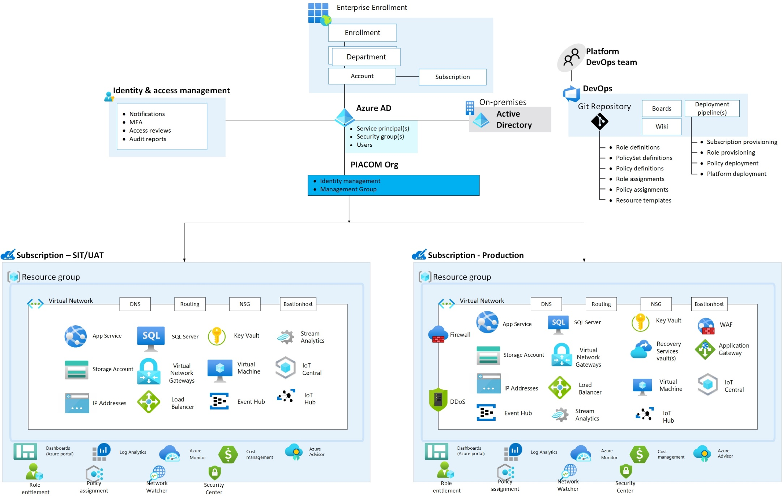
Azure Landing Zone

Slide 19
3. APPLICATION ASSESSMENT

Slide 20
ON-PREM APPLICATION | IMPACT AND READINESS RATING
In conjunction with Azure readiness, all applications were assessed with the customer for impact based on the following criteria:
Critical/non-critical
Windows and SQL Support
Customer priority
3 Applications have been identified as good candidates for phase 1:
Corporate governance (BOS Framework): Quản trị doanh nghiệp
Inventory management (Nuclos): Quản lý kho
Back-end Mobile
Application Name | # of Users | User Base | Application Server | Database Server | Application Server IP | Development Language | Database Name
BOS Framework | 10000 (TBU) | Application account | PTSHaTay-DB |  | 10.59.254.55 | .Net 2.0 | SQL
Nuclos Framework | 100 | Application account | PIA-ERP-DuAn | VNM-HCMC-S0640 / VNM-HCMC-S0690 | 10.59.254.60 | Java Angular | piadevdb
Back-end | 10000 (TBU) | Application account | MOBILE-APP | MOBILE-APP | 10.59.254.104 | C# | MOBILE_BACKEND_DEV

Slide 21

Journey to Cloud
Application
Cloud
Cloud
Modernization
Data
Migration
Infrastructure
Re-host
Redeploy as-is to cloud
Refactor
Re-architect
Materially alter/decompose application to services
Rebuild
New code written with
Cloud-Native approach
Replace
Discard existing apps & use
commercial software
Description
Minimally alter to take
better advantage of cloud
Reduce Capex
Free up datacenter
space
Quick cloud ROI
Faster, smaller updates
Code portability
Greater cloud efficiency
App scale and agility
Easier adoption of new cloud capabilities/ technologies
Mix technology stacks
Accelerate innovation
Build apps faster
Reduce operational cost
Standardizing around industry best
practices
Accelerating adoption of business process-driven approaches
Reallocating development investments
Business Drivers
(resources, speed, cost)
IaaS
Containers
PaaS Serverless M*-services
SaaS
Core Technologies
PaaS IaaS
Business Results
IaaS: 435% ROI, 73% reduction in PaaS: 466% ROI, 80% time saved, 5.91M NPV, 50% faster deployments.
datacenter footprint and 83% Container: 13x more releases, 10x cost reduction, 65% faster developer onboarding, 62% better availability. reduced IT outsourcing cost.

Slide 22



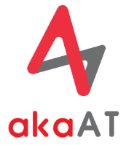



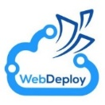




Cloud Migration Strategy
Strategy
Assessment & Discovery
Implementation
Testing & Optimization
Operation
Stakeholder Liaison
KPIs & Performance Baselines
App Dependency Maps Creation
Migration Strategy Planning
High Level App Designs
Cost Estimation
Re-hosting & Configuration
Refactoring
Database Conversion
Application/Service Conversion
Third-party Apps Integration
Data Migration
Functional Testing & Network Testing
Performance Testing
Usage Optimization & Efficiency Improvement
Production Verification
Rollback/Production Cutover
Infra Management
Application Management
Database Administration
Security Management
Metrics, Logs & Cost Monitoring
Incident Management
Delivery
Scope, RACI, cost & roadmap of project
Application inventory report
Migration solution & plan
Migrated applications/systems & data
Updated source code of applications and databases
Developer guideline documents
Test cases & testing reports
Systems goes live in the new platform
Improvement & enhancement solutions
Monitoring and telemetry report
Tools
OR
Azure Migrate
(Former Attunity)
Katalon Automation Test
Azure Monitor
Azure Log
Azure Migrate
SQL Server
Migration Assistant
AZCopy
SQL Server
Migration Assistant
Web Deploy
Prometheus
SQL Server Profiling

Slide 23
Application Modernization Strategy
Monolithic
Macro-services
Mini-services
Micro-services
Monolith Application
Service Domain
Service Domain
Service Domain
Service Domain
Service A
Service B
Service D
Service Domain
Service Domain
Service C
Monolith Application
App Server
App Server
App Server
Runtime
Runtime
RT
RT
RT
RT
Data Store
Data Store
Data Store
Data Store
Data Store
Greater data integrity, lower architectural complexity
Looser coupling, greater development agility, increased deployment portability/flexibility, more precise scalability

Slide 24
3.1 BOS Framework

Slide 25
BOS Framework -> ERP
Mục tiêu của phần mềm là các ứng dụng trong các hoạt động quản lý doanh nghiệp,bao gồm quản lý toàn bộ các khâu trong doanh nghiệp từ quản lý tài chính kế toán, quản lý thương mại, hàng hóa, quản lý sản xuất, quản lý nhân sự,quản lý tài sản thiết bị, quản lý các quy trình xử lý đối tượng (công văn, sự kiện, dự án), vv.
Mô hình triển khai hệ thống ERP cho Tổng công ty Vận tải Petrolimex:
Phân hệ quản lý của hệ thống:
Mua hàng
Bán hàng
Kế toán tài chính
kế toán quản trị
Quản lý vận tải
Hợp nhất báo cáo
- Hạ tầng: 1 máy chủ APP, 1 Máy chủ DB tại trung tâm dữ liệu củ Piaocm
- Khách hàng truy cập thông qua User App

Slide 26
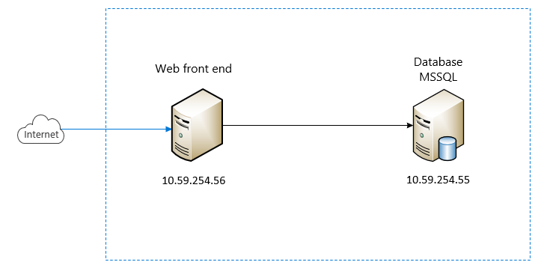
Current Architecture | BOS Framework

Slide 27
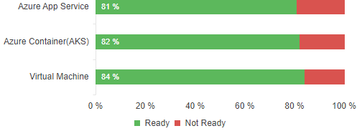
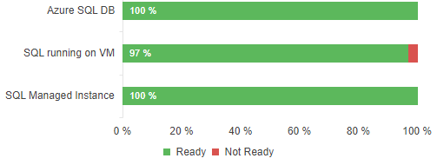
Findings | BOS Framework
Application Details
General description: | The purposes are for applications in business management, including management in all stages of the business, finance-accounting management, commercial management, goods management, manufacturing management, human resources management, assets management, and business process management (dispatches, events, projects…)
Critical/Non-critical? | Critical
App type | Lines of code | App Platform
Web Application | 365990 | .Net 2.0
Database type | Server Edition | Size
MSSQL | Standard Edition (64-bit) | 1 GB
Readiness Status
Readiness Status
Azure App Service
Azure Container (AKS)
Azure Virtual Machine
Azure SQL DB
SQL running on VM
SQL Managed Instance
S3 ( USD $ 292.80)
DS3 v2: 4 vCPUs (2 Nodes) ( USD $ 849.12)
DS3 v2 ( USD $ 424.56)
Gen 5 4 vCore ( USD $ 823.07)
D3 ( USD $ 764.21)
USD $ 823.08
Recommendation: Azure Virtual Machine
Recommendation: SQL Managed Instance is a general-purpose relational database service that supports structures such as relational data, JSON
Why: .Net 2.0
Why: Highly scalable without downtown. Enable Failover clustering in minutes.

Slide 28
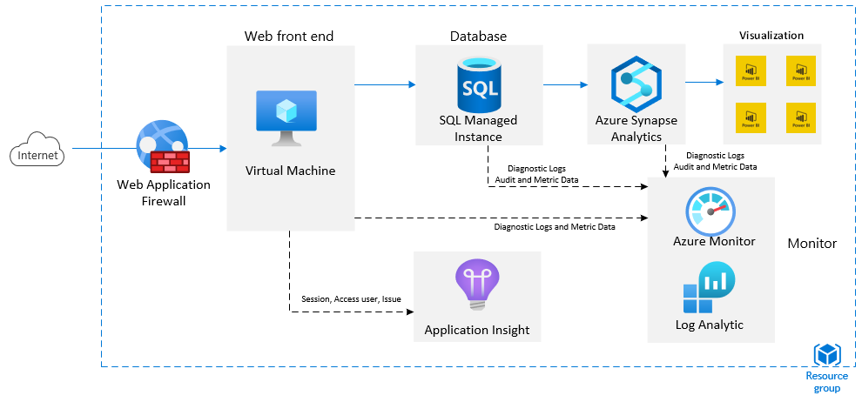
Azure Reference Architecture | BOS Framework
Notes:
Done

Slide 29
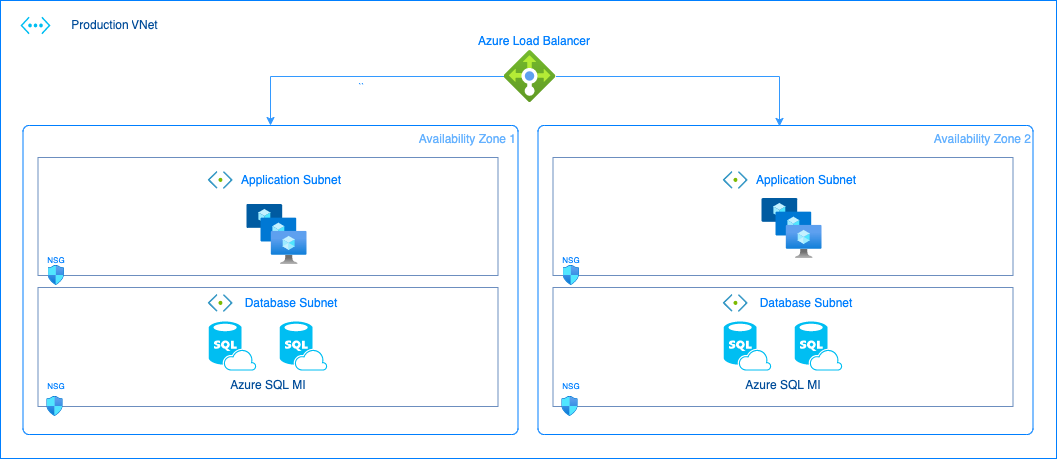
Rehost Methodology
Re-host High Level Solution architecture

Slide 30
As-is On-Premise BOS
System Architecture
Frontend
*) Entity Mgmt
Structure
Behavior
Rendering rules
Javascript GUI Utilities (Utils.js)
Dbtab.js
Backend
*) Transaction Mgmt
Structure
Behavior
Rendering rules
Entity Management
Transactional Management
Data Access
Libraries
Logging
*) Libraries
UI Forms
UI supports
…
Report
Printing

Slide 31
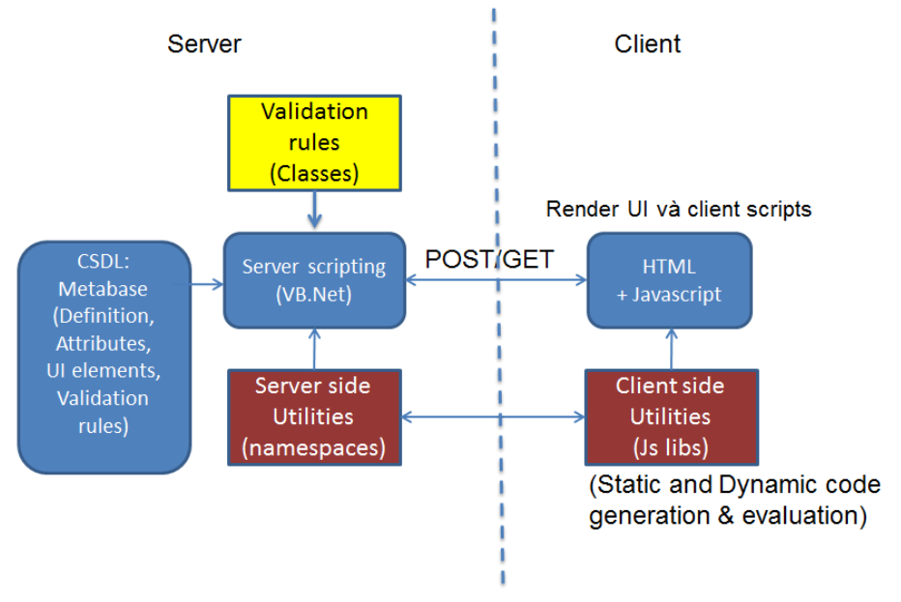
As-is On-Premise BOS
BOS Architecture

Slide 32
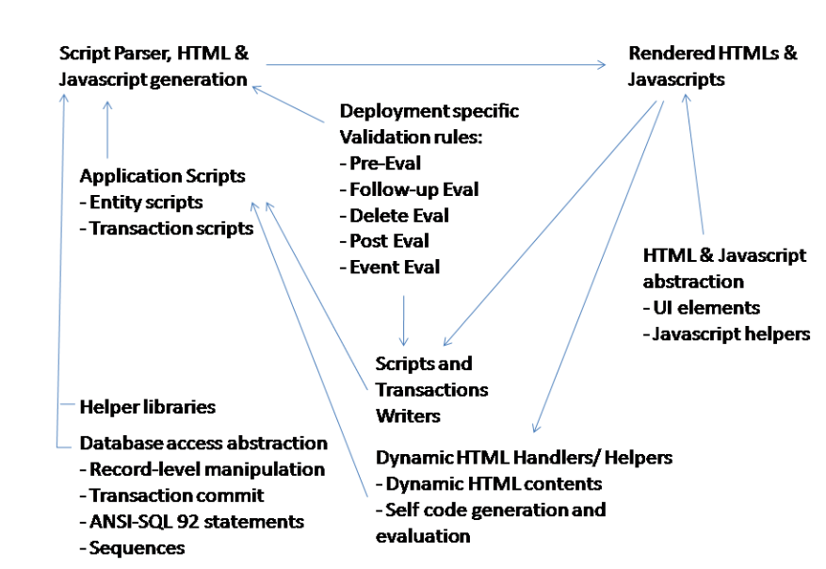
As-is On-Premise BOS
BOS Client side content generation

Slide 33
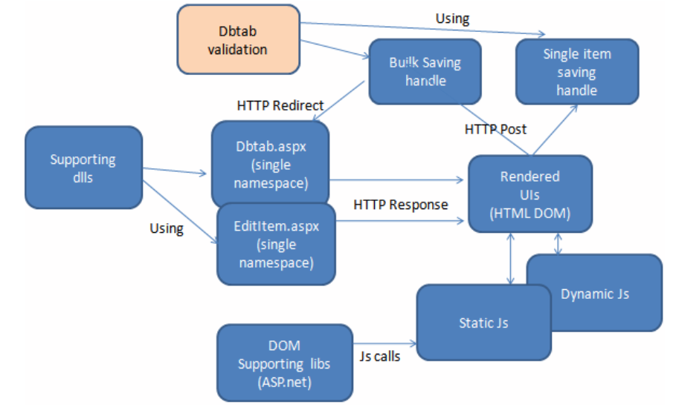
As-is On-Premise BOS
Scripting Master Data Metabase

Slide 34
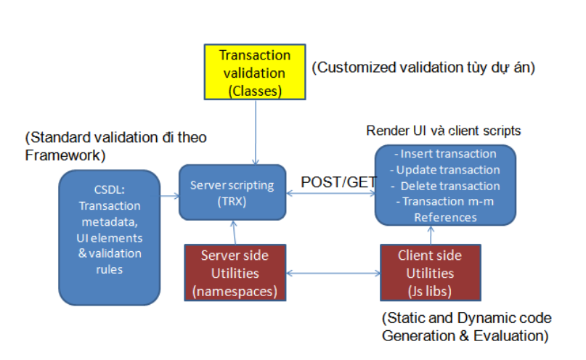
As-is On-Premise BOS
Scripting of Transaction Metabase

Slide 35
Migration Strategy
Process Re-host and then Re-architect
1. Re-host
Migrate As-is to cloud
2. Reflatform
(Optimize with cloud native)
Stage 1
Stage 2
3. Re-architect
(Multi-tenancy)
4. Re-factor
(From monolithic to microservices)
5. Dockerize
(CI/CD on K8S cluster)

Slide 36
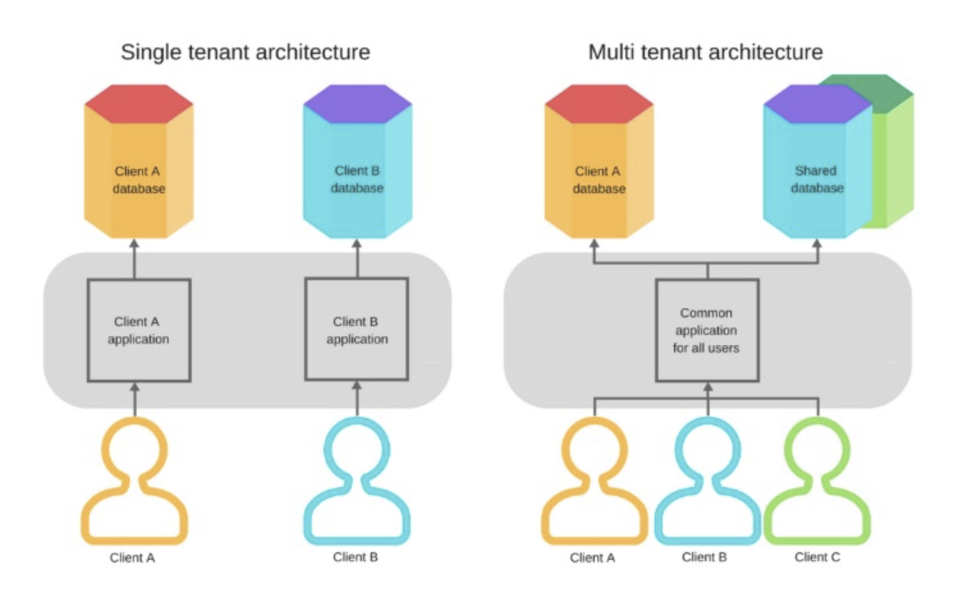
Migration Strategy
Re-architect Methodology
- Moving from Single tenant to Multi tenant architecture
Pros
Each client will have separate application and database so it will be hard to deploy.
Cons
- High infra cost when scale out.
Pros
Easy to deploy. One application
use for many tenant.
Low infra cost
Easy to scale out

Slide 37
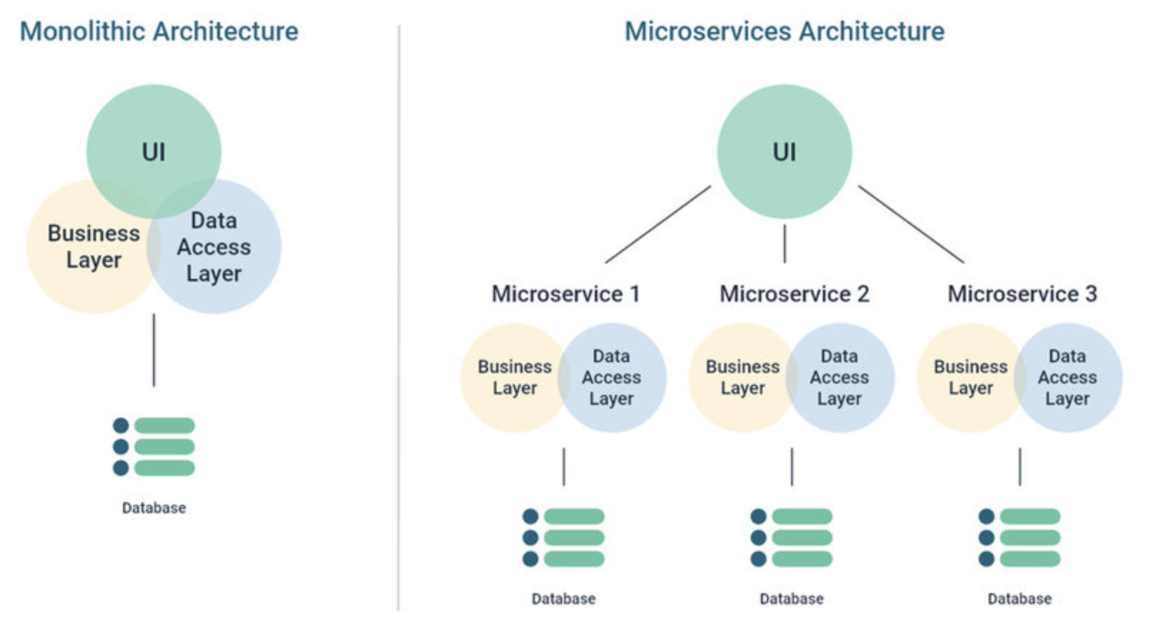
Migration Strategy
Refactor Methodology
- Moving from Monolithic to Microservices
Pros
Easy to maitain.
Easy to scale
Low dependency
Cons
Difficult to maintainance.
Difficult to scale.
High dependency

Slide 38
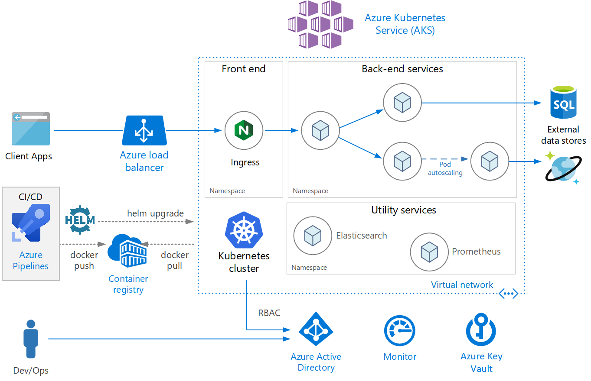
Rearchitect/Refactor Methodology
Refactor Methodology
- Microservices on Azure – Deployment Architecture (Dockerization)
Microservice will be deploy on AKS inside a container of a pod.
The Azure Pipeline will help to automate the code pipeline, docker pipeline.
AKS will help the backend for auto scaling.

Slide 39
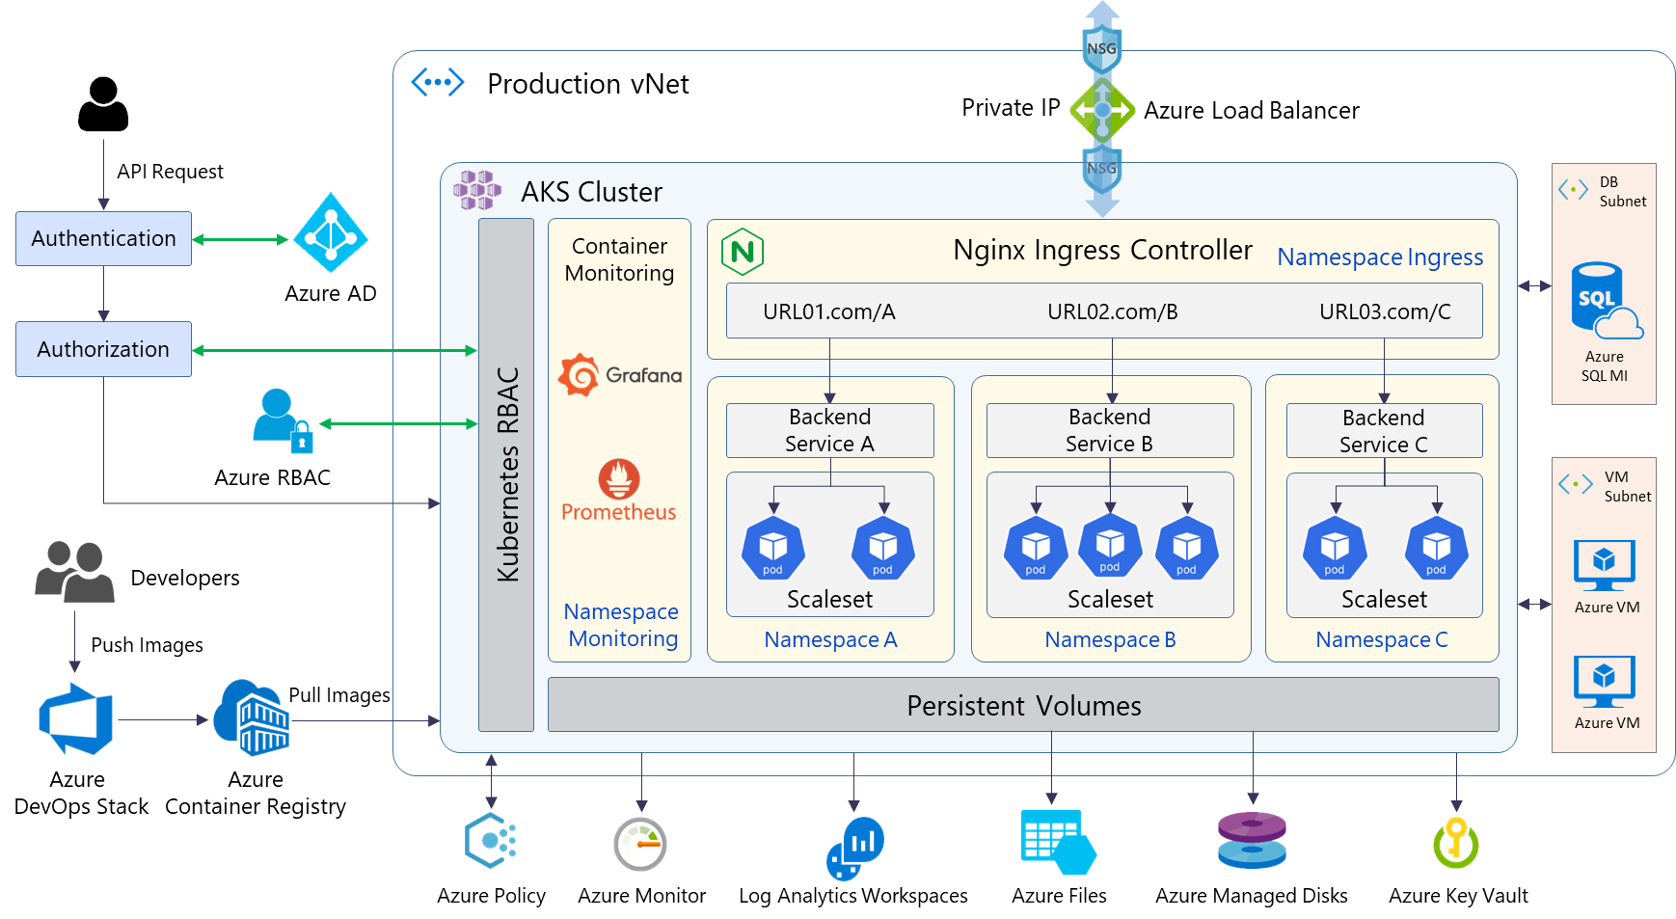
Rearchitect/Refactor Methodology
AKS Details
Key Highlights:
API requests will be authenticated through Azure AD and authorized via Azure RBAC & Kubernetes RBAC
Requests after that will be distributed load through Azure Load Balancer to the Nginx Ingress Controller and routed to appropriate backend services
Container monitoring will be combined Azure Monitor, Azure Log Analytics with Prometheus and Grafana stacks to monitor whole AKS cluster according to the best practices
Sensitive data in applications deploy in Kubernetes and certificates are stored and secured using Azure Key Vault
Governance policies (resource consistency, regulatory compliance, security, cost, and management) will be created and assigned by Azure Policy

Slide 40
3.2 NUCLOS FRAMEWORK

Slide 41
NUCLOS FRAMEWORK
- Nền tảng phát triển từ năm 2003 trên công nghệ Java Swing (Server) và Angular (Client) bởi hãng Novabit của Đức.
- Nền tảng có thể được cài đặt đa hệ điều hành (Windows, MacOS, Linux…)
- Có thể kết nối được với nhiều loại cở sở dữ liệu khác nhau (SQL Server, Oracle, PostgreSQL…).
- Kiến trúc theo mô hình một khối (monolithic)
* Các nội dung Piacom đã xây dựng trên Framework Nuclos
Xây dựng sản phẩm Piacom ERP bao gồm các phân hệ tương ứng với các Nuclet (Nuclet tham khảo trong tài liệu SAD):
pia.erp.common (Thư viện chung)
pia.erp.md (Master Data)
pia.erp.mm (Mua hàng)
pia.erp.sd (Bán hàng)
pia.erp.wm (Kho hàng)
pia.erp.fi (Kế toán)
pia.erp.co (Phân bổ chi phí)
pia.erp.tr (Vận tải)
2. Định hướng xây dựng hệ thống quản lý kho xăng dầu PTAS gồm các chức năng nghiệp vụ:
Quản lý nhập xuất
Kết nối hệ thống Hải Quan
View màn hình Scada dữ liệu tự động hóa

Slide 42
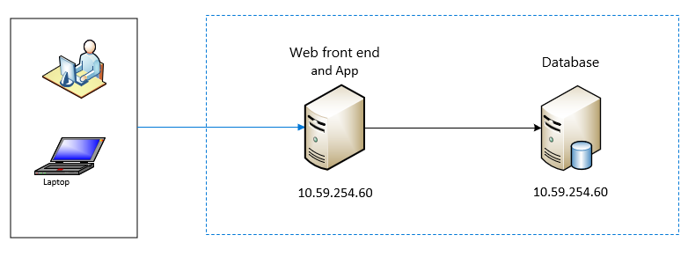
As-is Architecture | Nuclos Framework

Slide 43
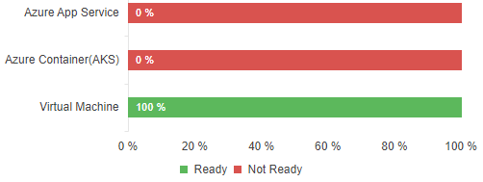
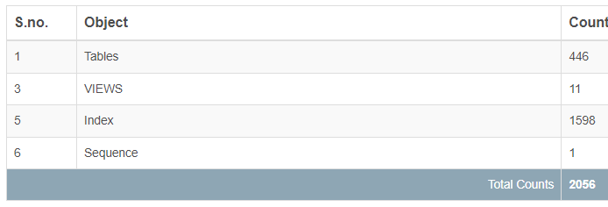
Findings | ERP (Nuclos Framework)
Application Details
General description: | Building Piacom ERP products including modules corresponding to Nuclet (Nuclet reference in the SAD): pia.erp.common (general library); pia.erp.md (Master Data); pia.erp.mm (Purchase); pia.erp.sd (Sales); pia.erp.wm (Warehouse); pia.erp.fi (Accounting); pia.erp.co (Cost Allocation – phân bổ chi phí); pia.erp.tr (Transports) Building petroleum warehouse management system includes following modules: Export and Import management, Customs connection – kết nối hải quan, SCADA automation screen.
Critical/Non-critical? | Critical
App type | Lines of code | App Platform
Web Application |  | Java
Database type | Database Version | Size
PostgreSQL | PostgreSQL 9.6.8 | 181 MB
Readiness Status
Readiness Status
Azure App Service
Azure Container (AKS)
Azure Virtual Machine
Azure Database for PostgreSQL
PostgreSQL running on VM
0
0
DS3 v2 ( USD $ 424.56)
Ram 8, 4 vCore ( USD $ 379.4688)
USD $ 823.08
Recommendation: Azure Virtual Machine
Recommendation: PostgreSQL running on VM, The source database version is not compatible for migration to the Azure Postgresql.
Why: App run window desktop
Why: Built-in high availability. Elastic scaling within seconds.

Slide 44
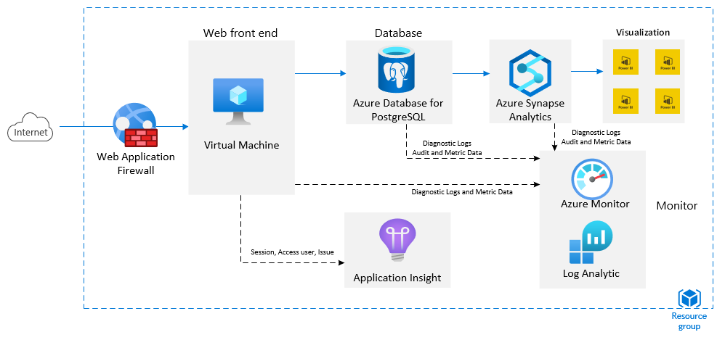
Azure Reference Architecture | Nuclos Framework

Slide 45
Rehost Methodology
Rehost High Level Solution Architecture

Slide 46
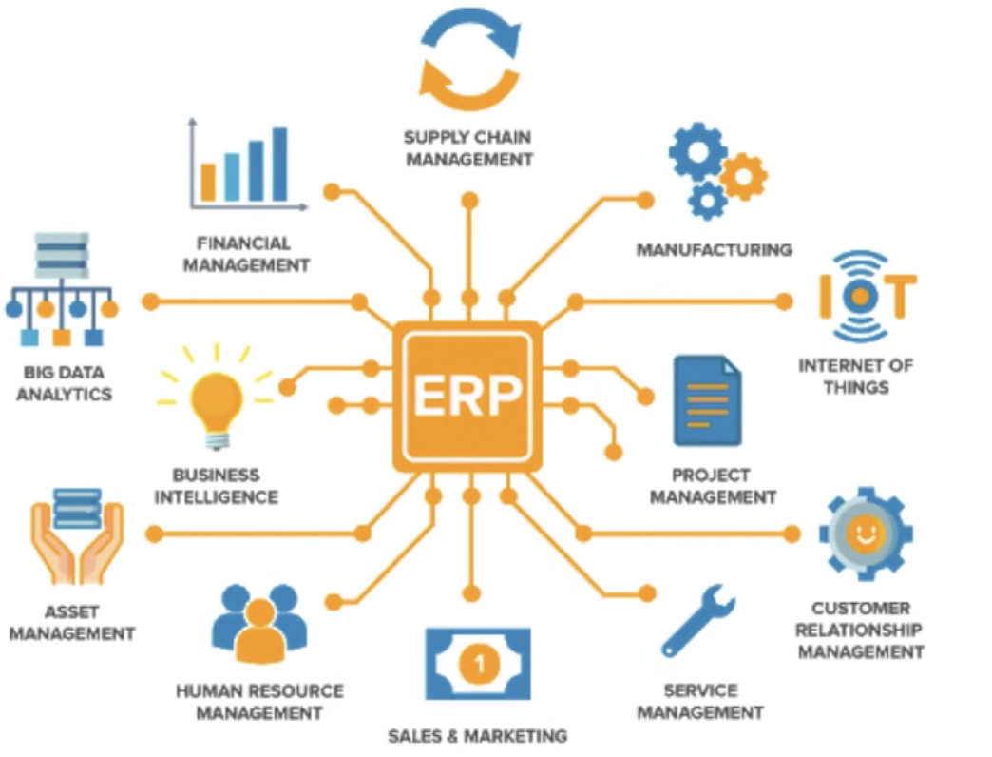
Nuclos Framework
Nuclos modules:
nuclos-schema
nuclos-common
nuclos-server
nuclos-client
nuclos-client-synthetica
nuclos-rigid-common
nuclos-rigid-server
nuclos-webclient
nuclos-layout-transformation
nuclos-war
nuclos-installer
nuclos-integration-tests
nuclos-integration-tests-rules
nuclos-integration-tests-businessobjects
nuclos-ccce

Slide 47
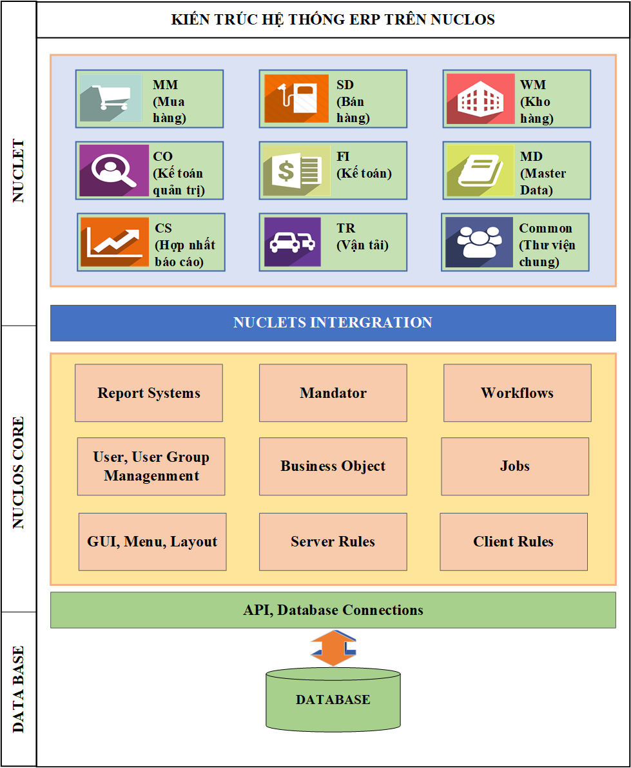
PIA-ERP As-Is Architecture

Slide 48
PIA-ERP Nuclet Components Diagram

Slide 49
Migration Strategy
Process Rehost and then Rearchitect/Refactor
1. Re-host
Migrate As-is to cloud
2. Reflatform
(Optimize with cloud native)
Stage 1
Stage 2
3. Re-architect
(Multi-tenancy)
4. Re-factor
(From monolithic to microservices)
5. Dockerize
(CI/CD on K8S cluster)

Slide 50
Rearchitect/Refactor Methodology
Re-architect Methodology
- Moving from Single tenant to Multi tenant architecture
Pros
Each client will have separate application and database so it will be hard to deploy.
Cons
- High infra cost when scale out.
Pros
Easy to deploy. One application
use for many tenant.
Low infra cost
Easy to scale out

Slide 51
Rearchitect/Refactor Methodology
Refactor Methodology
- Moving from Monolithic to Microservices
Pros
Easy to maitain.
Easy to scale
Low dependency
Cons
Difficult to maintainance.
Difficult to scale.
High dependency

Slide 52
Rearchitect/Refactor Methodology
Refactor Methodology
- Moving from Monolithic to Microservices
Monolithic
Azure Kubernetes Service (AKS)
MM
SD
MM
Database
WM
CO
WM
Database
FI
MD
CS
TR
…
Database
Common
Database

Slide 53
Rearchitect/Refactor Methodology
Refactor Methodology
- Microservices on Azure – Deployment Architecture (Dockerization)
Microservice will be deploy on AKS inside a container of a pod.
The Azure Pipeline will help to automate the code pipeline, docker pipeline.
AKS will help the backend for auto scaling.

Slide 54
3.3 BACK-END MOBILE

Slide 55
BACK-END MOBILE
Xây dựng hệ thống back-end cho các ứng dụng Mobile theo kiến trúc Microservices sử dụng nền tảng .Net Core 6.Back-end cho phép nhiều ứng dụng Mobile, Web kết nối đến. Dữ liệu được tổng hợp từ nhiều nguồn khác nhau:
ERP
EGAS
TAS
IoT

Slide 56
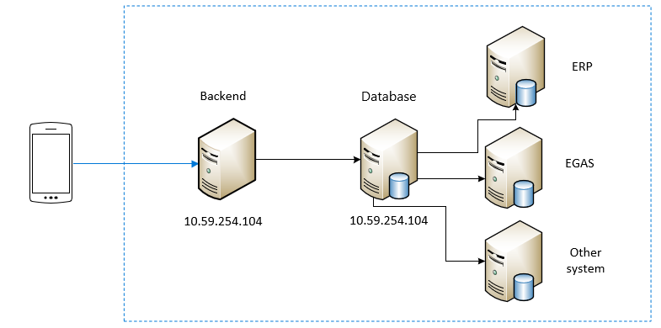
Current Architecture | Back-end Mobile

Slide 57
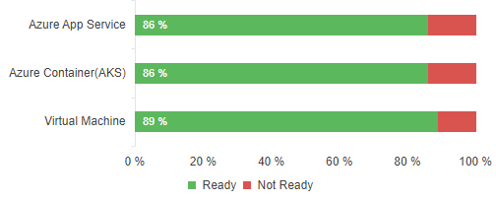
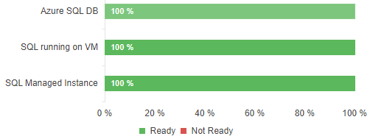
Findings | Back-end Mobile
Application Details
General description: | Back-end allows connections from multiple Mobile, Web applications. Data collected from different resources such as ERP, EGAS, IoT, TAS
Critical/Non-critical? | Non-critical
App type | Lines of code | App Platform
Web Application | 41010 | .Net core 6
Database type | Server Edition | Size
MSSQL | Enterprise Edition (64-bit) | 1 GB
Readiness Status
Readiness Status
Azure App Service
Azure Container (AKS)
Azure Virtual Machine
Azure SQL DB
SQL running on VM
SQL Managed Instance
S3 ( USD $ 292.80)
DS3 v2: 4 vCPUs (2 Nodes) ( USD $ 849.12)
DS3 v2 ( USD $ 424.56)
Gen 5 4 vCore ( USD $ 823.07)
D3 ( USD $ 764.21)
4 vCore ( USD $ 823.08)
Recommendation: Azure Container (AKS) enables you to build and host web applications in the programming language of your choice without managing infrastructure.
Recommendation: SQL Managed Instance is a general-purpose relational database service that supports structures such as relational data, JSON
Why: Highly scalable without downtown. Enable Failover clustering in minutes.
Why: This application is a good choice to move to Azure App Services, as it has no blockers & has additional features without any cost.

Slide 58
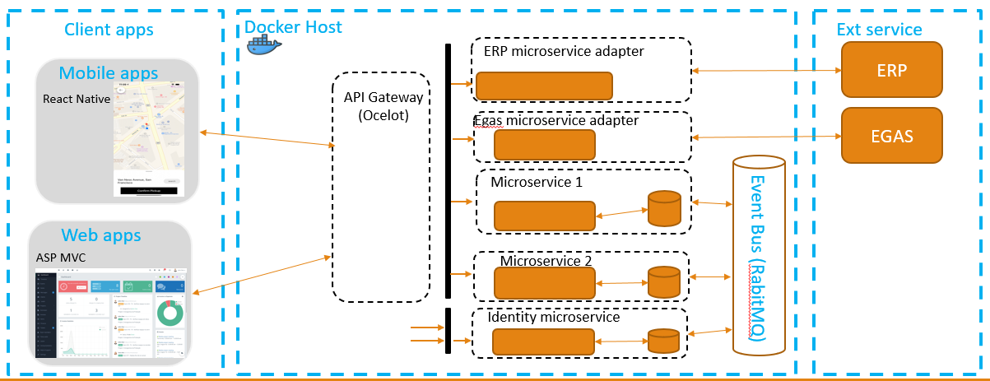
As-Is System High Level Architecture
Microservices Ready, able to migrate to AKS

Slide 59
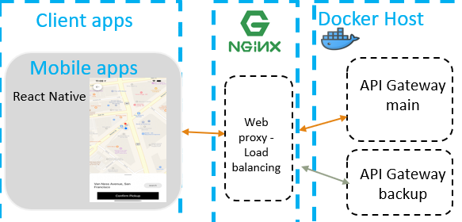
As-Is System High Level Architecture
Microservices Ready Deployment architecture

Slide 60
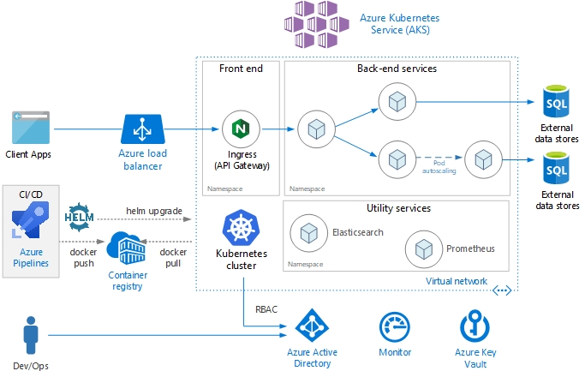
Azure Microservices Architecture Reference | Back-end Mobile

Slide 61
3.4 IOT

Slide 62
IOT
Piacom hiện đang cung cấp giải pháp quản lý cửa hàng xăng dầu cho khoảng trên 3500 cửa hàng, mục tiêu mở rộng lên khoảng 17.000 cửa hàng tại Việt Nam và một số nước Đông Nam Á. Tại mỗi CHXD cần quản lý và thu nhận dữ liệu từ các thiết bị:
Trung bình có 5 trụ bơm tương ứng với khoảng 20 vòi bơm
4 bể chứa nhiên liệu trong đó có các thiết bị tđh như que đo
2-3 máy tính cần quản lý tập trung
Ngoài ra còn có các hệ thống camera giám sát, cảnh báo và các thiết bị IoT khác
Quản lý Kho xăng dầu:
Thu nhận số liệu về lượng hàng xuất, nhiệt độ, điểu khiển bơm, van, họng xuất…
Điểu khiển phối trộn nhiên liệu
Kiểm soát các điều kiện an toàn trong quá trình xuất hàng: tiếp địa, báo tràn, dừng khẩn cấp trên họng xuất
Giám sát thời gian thực đo mức bồn chứa
Hỗ trợ tính toán trên thiết bị lưu lượng kế qua đường ống
Quản lý, thu nhận tín hiệu từ các thiết bị cảnh báo: rò rỉ, báo tràn, cảnh báo cháy…
Yêu cầu: Giải pháp tổng thể quản lý, vận hành và giám sát các thiết bị tại CHXD và Kho xăng dầu trên Azure Cloud (tích hợp, thu nhận tín hiệu; lưu trữ, cấu trúc hóa và trích trọn thông tin dữ liệu lớn; phục vụ phân tích và trực quan hóa dữ liệu)
Một đơn vị là 6GB cho 3 năm, có 68 đơn"

Slide 63
IoT Device
No. | Device Name (per unit) | Description | Quantity | Total
1 | Fuel Machine | Tatsuno Protocol | 5 | 17500​
2 | Liquid level sensor | Veeder root protocol | 15 | 52500
3 | Máy POS | tcp/ip socket, link with HDBank, Viettinbank | 4 | 14000
4 | Price board | tcp/ip socket | 1 | 3500​
5 | Batch controller | Modbus TCP, Modbus RTU. Modbus ASCII, OPC Server​ | 1 | 3500​
6 | PLC | connect to the company's copyrighted software | 1 | 3500​
7 | box for receiving tank measurement signal | RS485, RS232, OPC Server​ | 1 | 3500​
8 | Automation control machine | Collect data, control devices | 2 | 7000​
9 | Camera | Smart | 1 | 3500

Slide 64
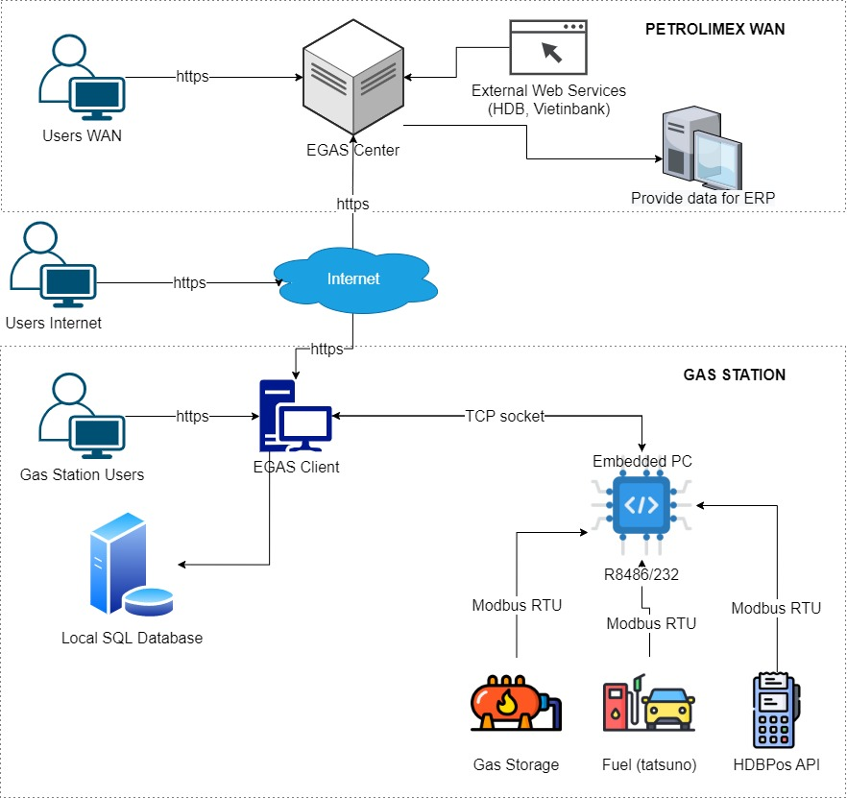
General model of store management application
To be IoT Egde Device

Slide 65
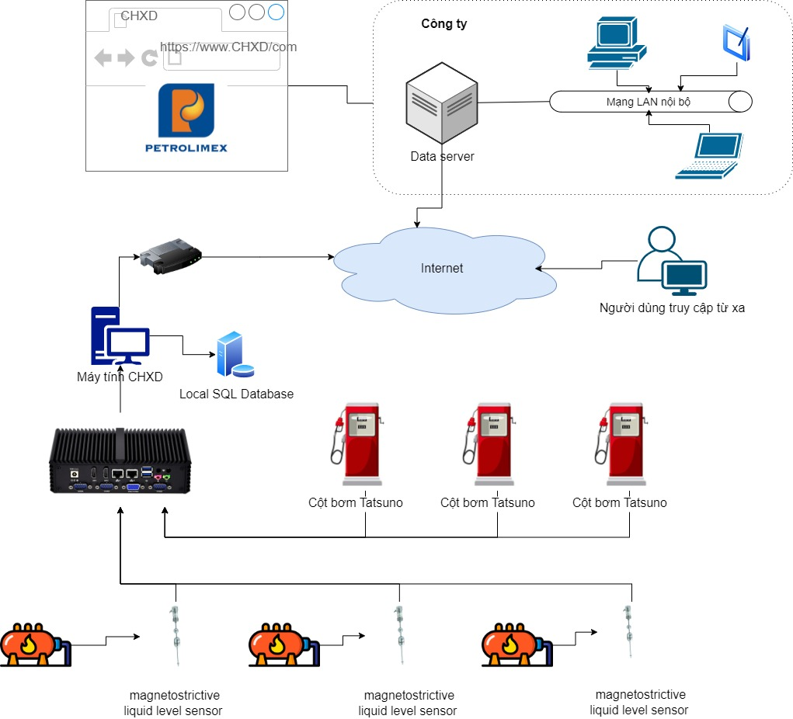
Petroleum station automated system
To be IoT Egde Device

Slide 66
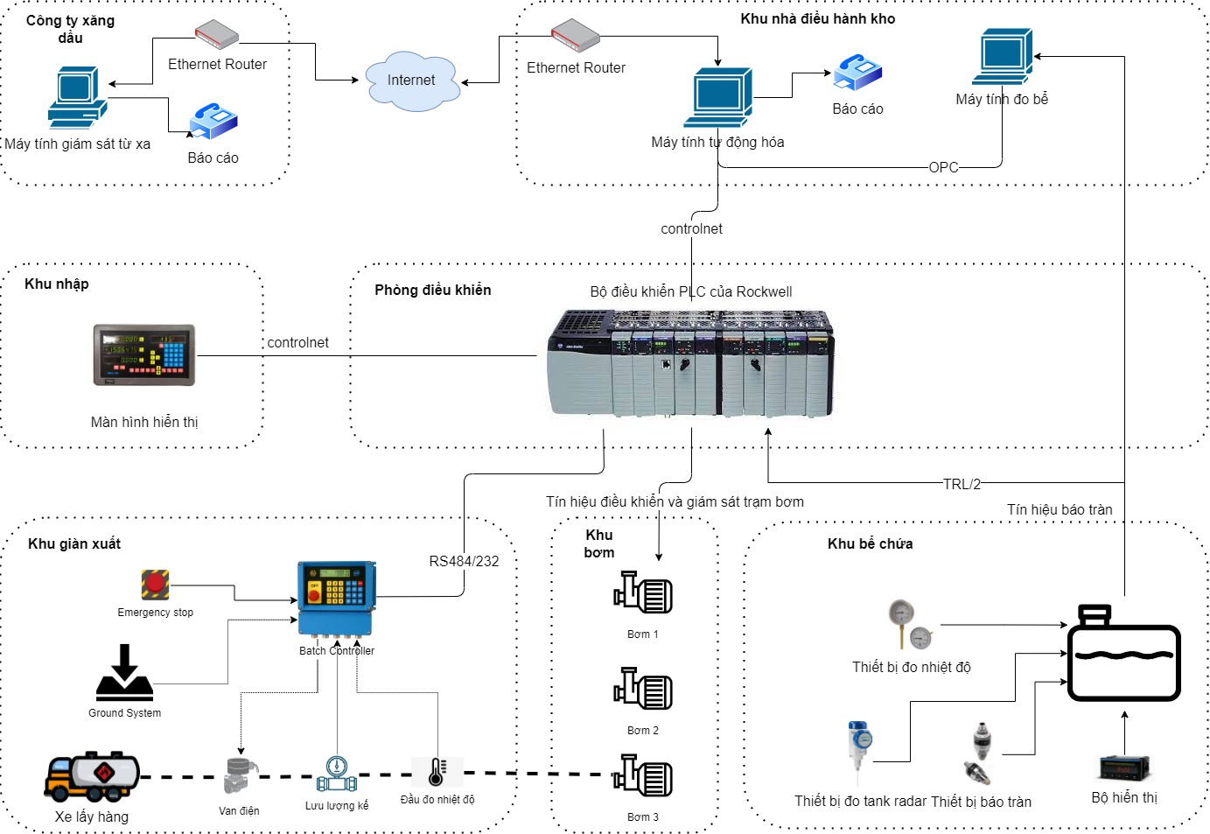
Petroleum warehouse automated system
To be IoT Egde Device

Slide 67
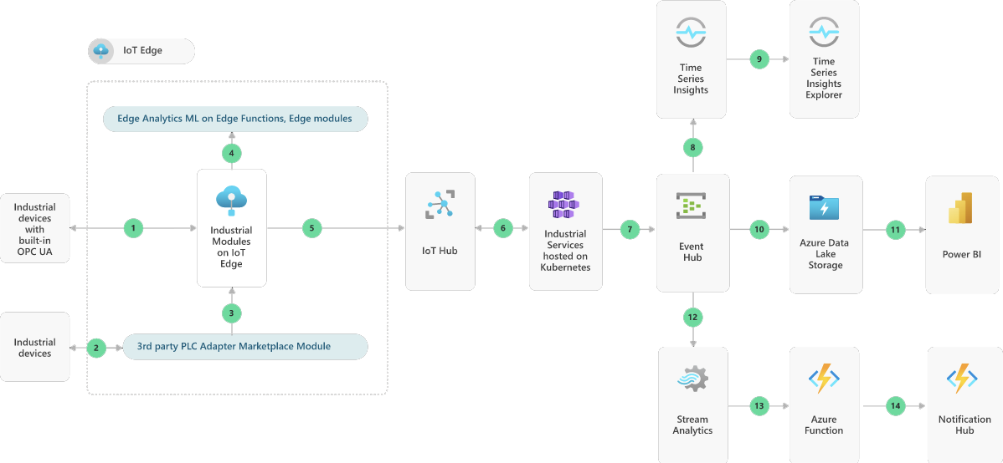
Apply Azure IoT Hub/Central Methodology
Condition Monitoring for Industrial IoT
This solution idea demonstrates how end manufacturers can connect their assets to the cloud using OPC UA (Open Platform Communication Unified Architecture) and the Industrial Components. They can monitor their equipment's key parameters to discover anomalies before they become critical issues. OPC UA is a platform-independent and service-oriented interoperability standard for a secure and reliable data exchange. OPC UA is used by various industrial systems and devices such as industry PCs, PLCs, and sensors. It's a standard that is driven by the OPC Foundation.

Slide 68
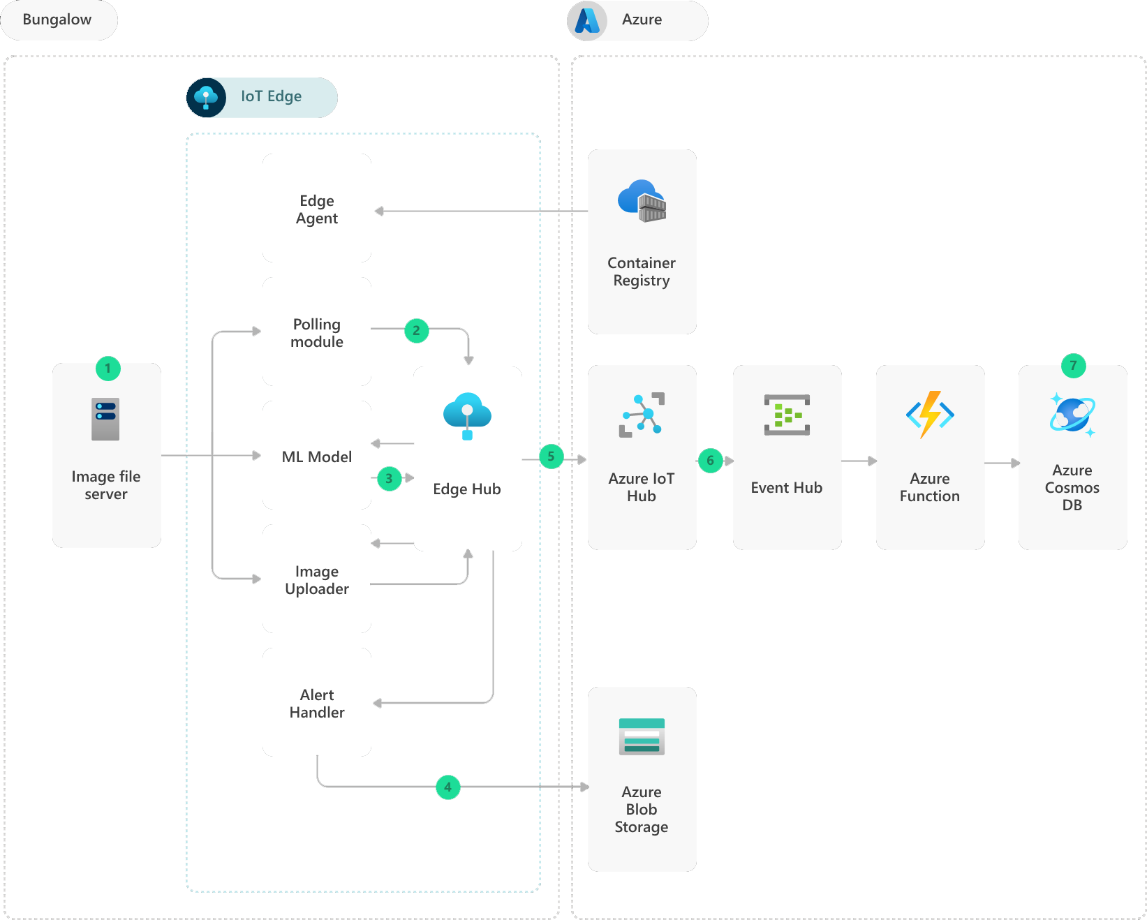
Apply Azure IoT Hub/Central Methodology
IoT Edge railroad maintenance and safety system
This solution is ideal for the transportation, telecommunications, and manufacturing industries. It focuses on the following scenarios:
A telecommunications network that has to maintain 99% or better uptime.
Production quality control, equipment repair, and predictive maintenance in a factory.
A transportation safety system that must process real-time streaming data with little or no latency.
Transit systems that need to provide timely schedule notifications and alerts.

Slide 69
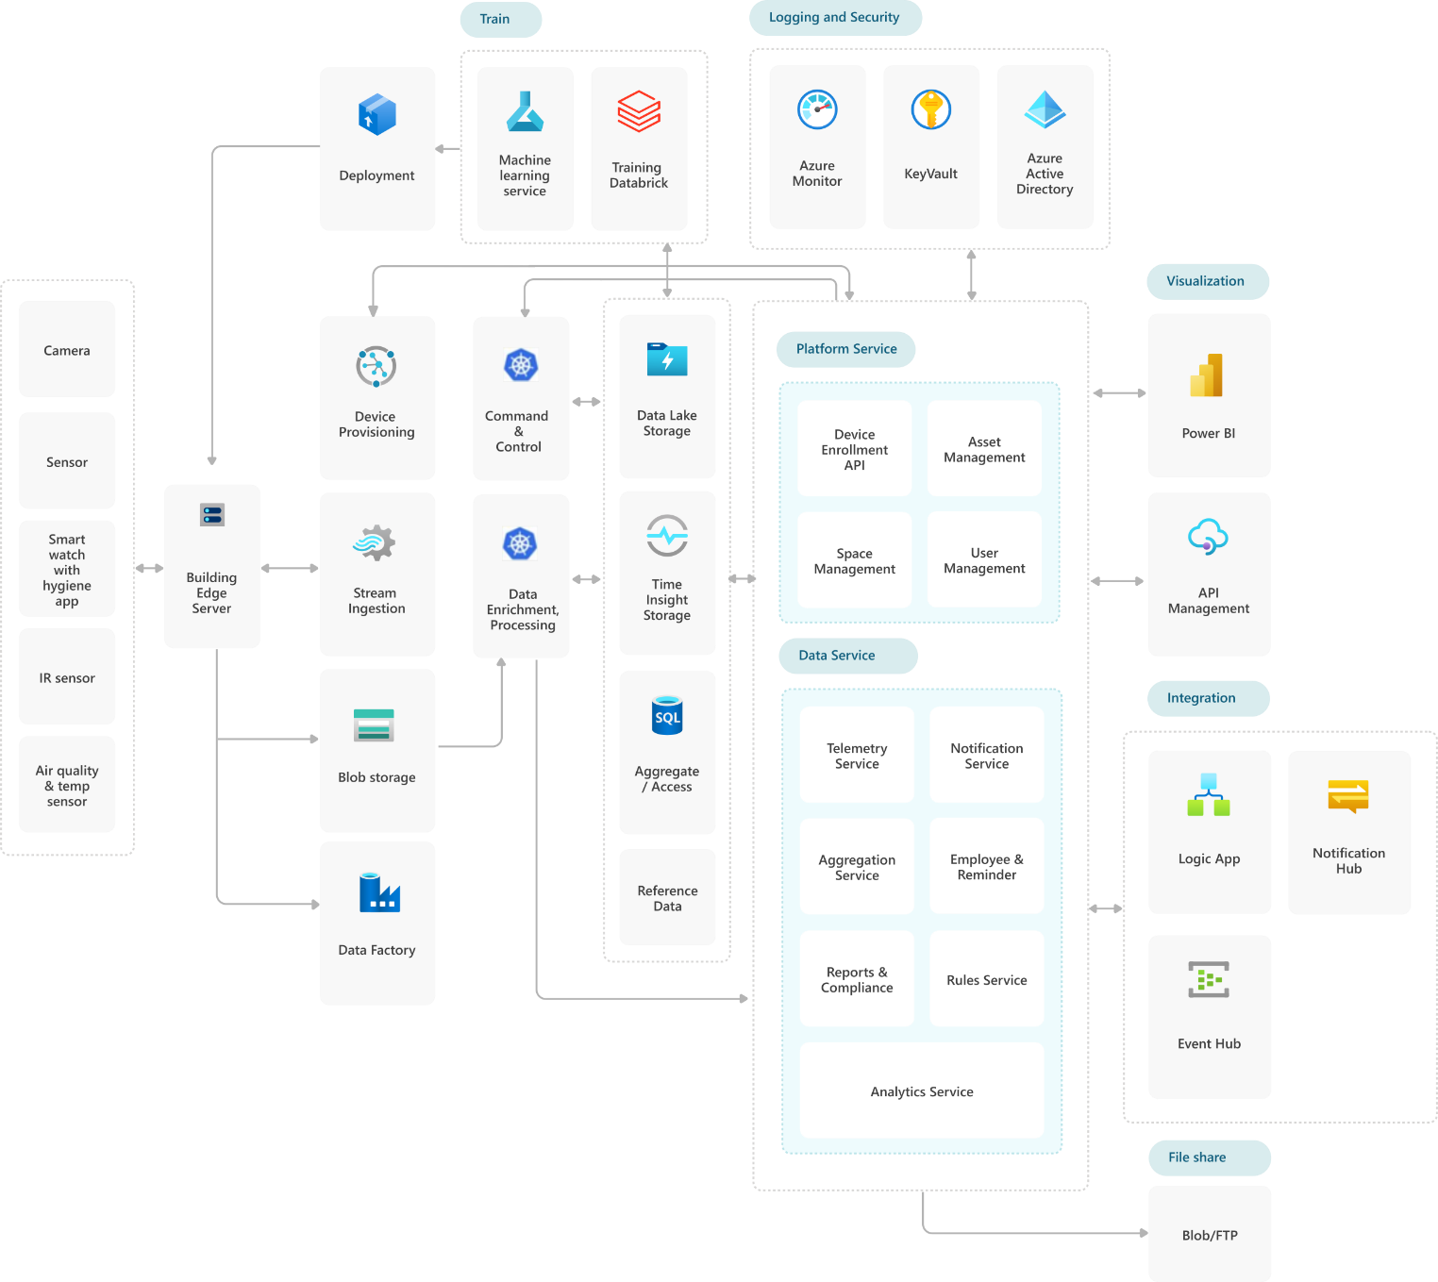
Apply Azure IoT Hub/Central Methodology
Cognizant Safe Buildings with IoT and Azure
Safe Buildings adapts to stores, offices, factories, warehouses, recreation spaces, hotels, and restaurants. It's adaptable to any interior space where people congregate.

Slide 70
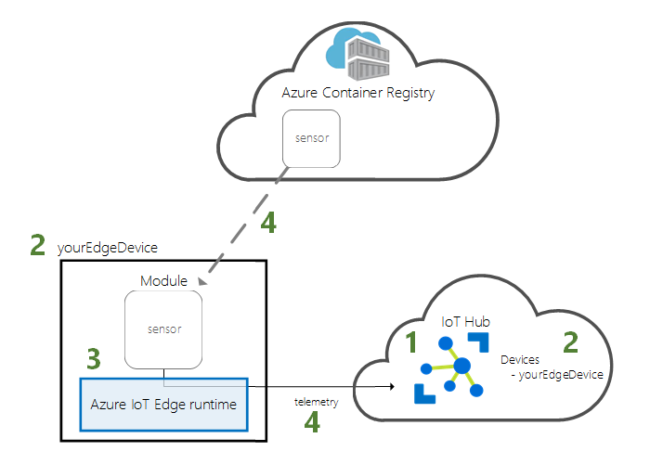
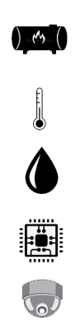
Apply Azure IoT Hub/Central Methodology
PIACOM IoT devices must have compatibility with Azure IoT Edge (can install and configure to be IoT Edge Device)
IoT devices will be registered with IoT Hub to be Edge devices.
The device could be any embedded pc which were installed and run with Linux or any OS.
The custom module will be registered on to Azure Container Registry.
When install the module, IoT Edge device will pull the image from registry, install as a daemon service and control (start/stop) with Edge Agent.
Convert to Azure IoT Central Solution by adding a dashboard that allows you to connect, monitor, and manage your IoT devices.
3rd Party Repo

Slide 71
IoT Cloud Migration Strategy
Strategy
Assessment & Discovery
Implementation
Testing & Optimization
Operation
Check compatibility of devices with IoT Edge.
Implement custom module to fit with PIACOM businesses (as docker container).
Module register testing
IoT Edge integration test
UAT
Application Management
Database Administration
Security Management
Metrics, Logs & Cost Monitoring
Incident Management
Register module with Azure Container Registry (DEVOPs)
IoT Edge Integration
Delivery
List of devices which compatible with Azure IoT Edge.
Module code
Code pipeline (DEVOPs)
IoT Edge System
Test cases & testing reports
Systems goes live
Improvement & enhancement solutions
Monitoring and telemetry report

Slide 72




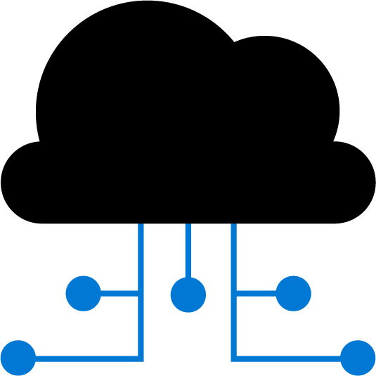

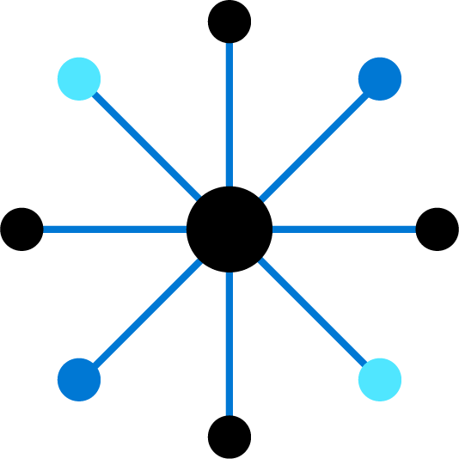





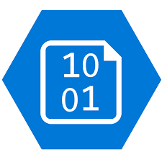

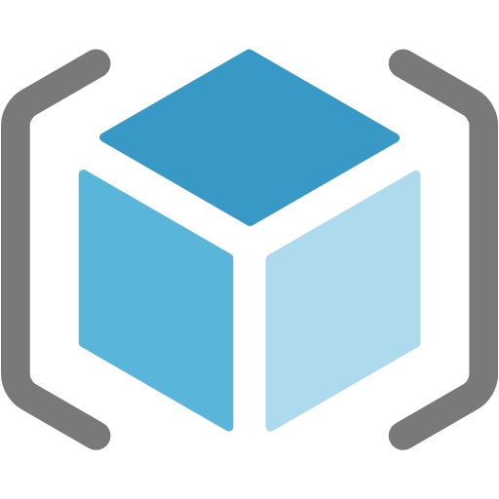









Building IoT solutions - Build from the ground up
The issue: Designing, integrating and maintaining dozens of individual services requires extensive expertise, time and financial investment
Azure IoT Device SDK
3rd Party Industry specific sensors & devices
(RTOS, Linux, Windows, Android, iOS)
Manage
View and manage solutions
Functions
SQL Azure
Web Apps
Power BI
Mobile Apps
Event Hub
Maps
Edge Modules:
Protocol Adaptation
Functions
Stream Analytics
Machine Learning
AI
IoT Hub
PowerApps
Web Apps
Azure IoT Edge
Device Provisioning Service
Time Series Insights
Key Vault
Azure Stream
Analytics
Business Integration
Connect to business apps & services
Container
Registry
Data Explorer
Cosmos DB
Application Insights
Dynamics 365
Kubernetes Service
Azure Sphere
Compute (VMs)
Office 365
Content Delivery Network
Storage
Resource Manager (ARM)
Domain Name System
Microsoft Flow
3rd Party applications
Secured MCU
Secured OS
Cloud Security
Service Bus
Front Door
Azure Security Center for IoT
Integrated view for CISO & SecOps personas to review enterprise security posture, including IoT solutions
Holistic view of IoT solution security posture for DevOps and IoT solution managers to review and manage day to day security status

Slide 73
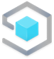
Building IoT solutions - Build with a complete management IoT app platform
The issue: Designing, integrating and maintaining dozens of individual services requires extensive expertise, time and financial investment
Azure IoT Device SDK
3rd Party Industry specific sensors & devices
(RTOS, Linux, Windows, Android, iOS)
Manage
View and manage solutions
Azure IoT Central
Build with Azure IoT Central, our IoT App Platform
Functions
SQL Azure
Web Apps
Power BI
Mobile Apps
Maps
Simplify production-ready IoT solution development:
Simplify setup, reduce management burden, operational costs, and overhead of a typical IoT project
Bring solutions to market faster, while staying focused on your customers
Edge Modules:
Protocol Adaptation
Functions
Stream Analytics
Machine Learning
AI
Event Hub
IoT Hub
PowerApps
Web Apps
Azure IoT Edge
Device Provisioning Service
Time Series Insights
Key Vault
Azure Stream
Analytics
Business Integration
Connect to business apps & services
Container
Registry
Data Explorer
Cosmos DB
Highly secure
Enterprise-grade
Predictable pricing
Industry-focused
Application Insights
Dynamics 365
Kubernetes Service
Azure Sphere
Compute (VMs)
Office 365
Content Delivery Network
Storage
Resource Manager (ARM)
Domain Name System
Microsoft Flow
3rd Party applications
Secured MCU
Secured OS
Cloud Security
Service Bus
Front Door
Azure Security Center for IoT
Integrated view for CISO & SecOps personas to review enterprise security posture, including IoT solutions
Holistic view of IoT solution security posture for DevOps and IoT solution managers to review and manage day to day security status

Slide 74
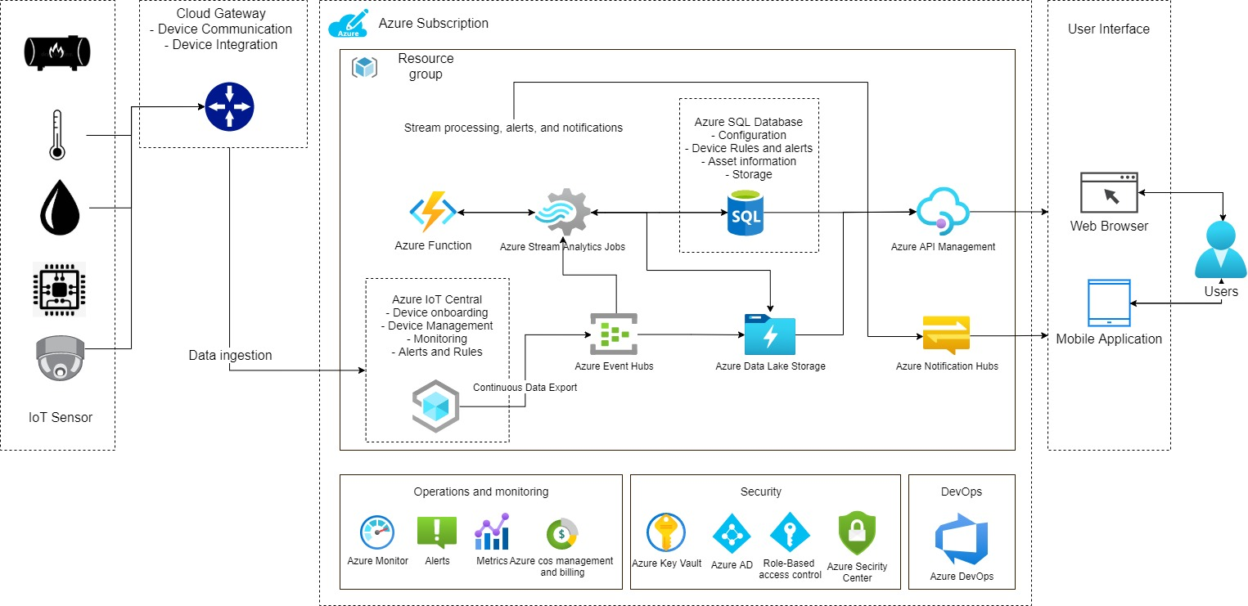
Real-time asset and management

Slide 75

AI Video Intelligence Solution Accelerator

Slide 76
4. TRANSFORMATION RECOMMENDATIONS

Slide 77
Mục tiêu
1. Mục tiêu của dự án
Không muốn tiếp tục đầu tư phần cứng bên dưới của hạ tầng on-premise (Đặt hàng phần cứng mất thời gian)
Giảm thiểu thời gian triển khai hệ thống cho các cửa hàng xăng dầu
Phát triển và triên khai thêm các tính năng mới cho các ứng dụng nhanh hơn
Tập trung hóa dữ liệu thuận thiện cho việc làm báo cáo và giám sát các hệ thống (IoT)
2. Mục tiêu kinh doanh của KH từ 1->5 năm tới
Hiện tại 3500 cửa hàng, tương lai lên đến 17000 cửa hàng
Mở rộng chi nhánh sang nước ngoài (Khu vực đông nam á)
Giảm chi phí vận hành hàng tháng
3. Chiến lược về IT
Chuyển dịch hạ tầng hiện tại lên Cloud
Xây dựng hệ thống microservice

Slide 78

PIACOM Current Infra Architecture

Slide 79

Azure Architecture Recommendation

Slide 80


Approach migration
Transformation based Cloud Adaption framework anchored from best practices and industry standards.

Slide 81

Migration processes
Aggregate data to execute a workload, constraint, & dependency analysis
Align sub-processes to fit the teams, roles, & responsibilities
Ensure every member of the team can use business outcomes as a test for decisions
Align sub-processes to fit change management and change approval processes across IT and business unit
Mature Assessment:
Quickly evaluate cloud compatibility
Align appropriate cloud architecture
Match the appropriate migration tool
Mature Migration:
Standardized process
Allow multiple migration tools
Enable limited workload modernization during migration
Mature Optimization:
Data-driven testing
Balance of performance and cost
Low impact promotion process
Consistent on-boarding
Mature Operations:
Integration with ops, governance, and security
High workload reliability
Well-governed environment.

Slide 82
Stage 1: Master Plan (Lift & Shift)
W1 | W2 | W3 | W4 | W5 | W6 | W7 | W8 | W9 | W10 | W11 | W12
Project readiness and administration
Assess Network/Infra
Assess Servers/Application
Cloud Assessment
Landing Zone Design/Implement
Landing Zone Design/Implement
App 1: Quản trị doanh nghiệp (BOS Framework) cho 1 đơn vị
Production Environment
Infra/Architecture Design Document
Migrate
App 2: Quản lý kho (Nuclos Framework)
Cloud Migration
Apps/Servers
Test
App 3: Back-end Mobile
Training
Hand-over
Assessment Report
Landing Zone Design
Landing Zone Resources
Knowledge Transfer
Cloud Managed Services
Start Managed Service
Security assessment

Slide 83
Stage 1: 3 Applications -> Lift & Shift (SIT Environment)
Category | Task | Description | Deliverables
Assessment | Assess IT Operational, Business, Model | - Understand the current IT operational models and document baselines - Business, Analysis, Solution Design & Plan | - Requirements, Operational Baselines - Report, recommendation
 | Technology Assessment | - Server, Network, Appplication, Security, Data | - Infra related 3 Apps - 3 Apps
Design | Design Network Topology & Connectivity | - Design connectivity to Cloud (VPN) - Defines how applications can communicate with each other - Plan for landing zone network Vnet and segmentation | - Network Topology & Connectivity Design fundamental
 | Design Security, Governance | - Plan for governance (determine what Cloud policies are needed, identify required Cloud tags and use the append policy mode to enforce usage) - Define security monitoring and an audit policy - Plan for platform security (shared responsibility} | - Security Fundamental - Governance methodogy Solutions Design
 | Design Management & Monitoring Solutions | - Plan platform management and monitoring - Plan for application management and monitoring | - Management & Monitoring Solutions Design fundamental
Deployment | Network Topology & Connectivity | - Deploy solutions for PoC applications - Enable tools native Azure | - Network Topology & Connectivity Deployment
 | Security, Governance | - Create and manage policy assignments - Service enablement framework - Enable tools native Azure | - Security, Governance Deployment - Policy
 | Management & Monitoring | - Deploy solutions for PoC applications - Enable tools native Azure | - Cellection log centre (Log Analytic) and monitor by Azure Monitor
Migration | Database Migration | - Migration Database on Cloud (Host in VM) SIT - Database SQL, PosgreSQL | - DBs of Apps on Azure
 | Application Migration | - Migration Lift & Shift | - VMs of 3 Apps
Testing | Application, Database | - Application | - Application run
Transfer | Documentation | - Make, take note Documentation - Report | - Documentations - Report

Slide 84
Stage 1: Team Structure (Lift & Shift)
PIACOM
Steering Committee
PIACOM : Cuong
FPT-DM:Thanh
FPT Unbillable
FPT Billable
Microsoft Unbillable
Project Manager
Offshore Project Manager
(1)
PIACOM Project Team
Microsoft Cloud
Solution Architect
Application Owner
Project Plan & Tracking
Solutions Architect
(N/A)
Cloud Engineer
(N/A)
Review Designs & Methodologies
Solutions Architect
Cloud Engineer
Requirements,
Technical Solution
Dev
(N/A)
DevOps
(N/A)
Dev
DevOps
SIT/UAT
QA
Tester
QA
(N/A)
Tester
(N/A)

Slide 85
Stage 2: Master Plan (Modernization and IoT)
M1 | M2 | M3 | M4 | M5 | M6 | M7 | M8 | M9 | M10 | M11 | M12 | M13 | M14 | M15 | M16 | M17 | M18
Project readiness and administration
Assess Network/Infra
Assessment
Assess Servers/Application
Landing Zone Design/Implement
Landing Zone Design/Implement
App 1: Quản trị doanh nghiệp (BOS Framework) cho 1 đơn vị
App 2: Quản lý kho (Nuclos Framework)
modernization
App 3: Back-end Mobile
App 4 IoT cho 1 đơn vị
Assessment Report
Landing Zone Design
Landing Zone Resources
Knowledge Transfer
Managed Services
Start Managed Service
Security assessment

Slide 86
Stage 2: Work Break down Structure (Modernization and IoT)
Category | Tasks | Description
BOS ERP
Env | Xay dựng môi trường thực thi (DEV, UAT, PROD) | Xây dựng môi trường phát triển, môi trường UAT, PROD cho on-premise và cloud.
BA | Tìm hiểu nghiệp vụ và xác định lộ trình cải tiến | Phân tích nghiệp vụ, xác định lộ tình thực hiện
Design | Thiết kế lại kiến trúc ứng dụng | Thiết kế tổng thể kiến trúc hệ thống theo hướng Multi-Tenancy và Microservices.
 | Thiết kế chi tiết | Chi tiết hoá các module quan trọng phục vụ POC
Dev | Xây dựng các MVP | Thực hiện các MVP (Minimum Value Project) để xác định tính khả thi của một số chức năng, hệ thống con trong tổng thể hệ thống
 | Thực hiện code refactor | Thực hiện chuyển hoá black-box, hoặc refactor mã nguồn hiện có theo hướng microservice và multi-tenancy
Testing | Functional Test | Test lại các chức năng phần mềm trên môi trường Dev
Deploy | Deployment | Triển khai hệ thống phần mềm trên các môi trường dev-> uat->prod
Testing | UAT Test | Thực hiện UAT Test
 | Security Test | Thực hiện Security Test
Training & Tech handover | Training courses and documents transfering | Đào tạo và chuyển giao công nghệ
Maintainance & Operation | Maintainance & Operation | Bảo hành và bảo trì

Slide 87
Stage 2: Work Break down Structure (Modernization and IoT)
Category | Tasks | Description
Quản lý kho (PIA-ERP, Nuclos)
Env | Xay dựng môi trường thực thi (DEV, UAT, PROD) | Xây dựng môi trường phát triển, môi trường UAT, PROD cho on-premise và cloud.
BA | Tìm hiểu nghiệp vụ và xác định lộ trình cải tiến | Phân tích nghiệp vụ, xác định lộ tình thực hiện
Design | Thiết kế lại kiến trúc ứng dụng | Thiết kế tổng thể kiến trúc hệ thống theo hướng Multi-Tenancy và Microservices.
 | Thiết kế chi tiết | Chi tiết hoá các module quan trọng phục vụ POC
Dev | Xây dựng các MVP | Thực hiện các MVP (Minimum Value Project) để xác định tính khả thi của một số chức năng, hệ thống con trong tổng thể hệ thống
 | Thực hiện code refactor | Thực hiện chuyển hoá black-box, hoặc refactor mã nguồn hiện có theo hướng microservice và multi-tenancy
Testing | Functional Test | Test lại các chức năng phần mềm trên môi trường Dev
Deploy | Deployment | Triển khai hệ thống phần mềm trên các môi trường dev-> uat->prod
Testing | UAT Test | Thực hiện UAT Test
 | Security Test | Thực hiện Security Test
Training & Tech handover | Training courses and documents transfering | Đào tạo và chuyển giao công nghệ
Maintainance & Operation | Maintainance & Operation | Bảo hành và bảo trì

Slide 88
Stage 2: Work Break down Structure (Modernization and IoT)
Category | Tasks | Description
Backend Mobile
Khảo sát chi tiết và tư vấn giải pháp | Khảo sát kiến trúc hiện tại của ứng dụng | Khảo sát kiến trúc hiện tại của ứng dụng
 | Đề xuất cải tiến | Các đề xuất cải tiến qui trình, thiết kế, mã nguồn để tối ưu trên môi trường cloud
 | Xây dựng các MVP | Xây dựng các MVP nếu có
IoT
Deep Assessment | IoT Edge Assessment (09 kind of device) | Đánh giá tương thích của các thiết bị IoT với Azure Hub
Env | Setup Envvironment for Azure IoT Central/ Azure IoT Hub (SIT, UAT, PROD) | Thiết lập các môi trường DEV, UAT,PROD
Dev | Thực hiện MVP | Thực hiện các MVP (Minimum Value Project) để xác định tính khả thi.
 | Implement Edge Module (09 kind of device) | Thực hiện chuyển đổi lên Azure IoT
Deploy | Deploy DEV Environment (09 kind of device) | Triển khai trên hệ thống DEV
 | Deploy UAT Environment (09 kind of device) | Triển khai trên hệ thống UAT
 | Deploy PROD Environment (09 kind of device) | Triển khai trên hệ thống PROD
Test | Testing/Fix bug SIT (09 kind of device) | Testing trên hệ thống DEV
 | Testing/Fix bug UAT(09 kind of device) | Testing trên hệ thống UAT
 | Testing/Fix bug PROD (09 kind of device) | Testing trên hệ thống PROD

Slide 89
Stage2: Team Structure (Modernization and IoT)
PIACOM
Steering Committee
PIACOM : Cuong
FPT-DM:Thanh
FPT Unbillable
FPT Billable
Microsoft Unbillable
Project Manager
Offshore Project Manager
(1)
PIACOM Project Team
Microsoft Cloud
Solution Architect
Application Owner
Solutions Architect
(N/A)
Cloud Engineer
(N/A)
Project Plan & Tracking
Review Designs & Methodologies
Requirements,
Technical Solution
Solutions Architect
Cloud Engineer
Dev
(N/A)
DevOps
(N/A)
SA IoT
(N/A)
Dev
DevOps
SA IoT
SIT/UAT
QA
(N/A)
Tester
(N/A)
Dev IoT
(N/A)
QA
Tester
Dev IoT

Slide 90
Org Alignment
The Cloud Strategy Team is responsible for leading the cloud adoption within your organization, supporting all business outcomes, people and processes changes and technical projects identified within this plan
PIACOM Cloud Team
Cloud strategy team
Cloud adoption team
Cloud operations team
Cloud platform team
Cloud automation team
Cloud governance team
The primary duty of cloud automation is to own and advance the solution catalog. The solution catalog is a collection of prebuilt solutions or automation templates
Cloud adoption teams are the modern-day equivalent of technical implementation teams or project teams. The nature of the cloud might require more fluid team structures.
Creation and support of your cloud platform or landing zones
Focus on delivering maximum workload performance and minimum business interruptions within an agreed-upon operations budget
A cloud governance team ensures that cloud-adoption risks and risk tolerance are properly evaluated and managed. The team identifies risks that can't be tolerated by the business, and it converts risks into governing corporate policies

Slide 91
Roles & Responsibilities
No | Roles | Responsibility
1 | Steering Committee | Coordinate all stakeholders (Parkway, FPT delivery team, Microsoft) Support team to communicate with the customer and relevant parties Monitor progress of the whole program
2 | Offshore Project Manager | Manage migration & build project work Monitor project progress, set deadlines Ensure each project is on time, on budget, and within the scope
3 | Cloud Solution Architect | Analyze and evaluate the system/applications Design technical architecture of the target system Review solution design for work items Manage engagement team Corporate with team to solve problems
4 | Software Developer | Read and understand system requirements Implement Code
5 | Cloud Engineer | Discover & assesses current environment Implement cloud governance Training & handover
6 | DevOps Engineer | Discover & assesses current environment Provision/deployment & configuration workloads/services in the cloud SIEM, 3rd parties integration Training & handover
7 | QA | Prepare test cases Execute functional & performance testing Create test reports
8 | Microsoft Cloud Solution Architect | Consult and review solution architecture, design and cloud infrastructure cost Coordinate with Microsoft side to get support for the project

Slide 92

Learning path
Azure Certifications:
https://docs.microsoft.com/en-us/learn/certifications/

Slide 93
Azure Service Pricing
No. | Services | Descripton
1 | App Service | App Service brings together everything you need to create websites, web APIs for any platform or device
2 | SQL Database | Azure SQL Database is the intelligent, scalable database service built for the cloud with AI-powered features that maintain peak performance and durability.
3 | Key Vault | Azure Key Vault enables Azure subscribers to safeguard and control cryptographic keys and other secrets used by cloud apps and services
4 | Stream Analytic | Azure Stream Analytics is an event-processing engine in the cloud that uncovers insights from data generated by devices, sensors, cloud infrastructure services, and applications in real time
5 | Virtual Network, Virutal Network peering | VNet enables many types of Azure resources, such as Azure Virtual Machines (VM), to securely communicate with each other, the internet, and on-premises networks.
6 | Azure Monitor | Azure Monitor maximizes the availability and performance of your applications and services by delivering a comprehensive solution for collecting, analyzing, and acting on telemetry from your cloud and on-premises environments
7 | Window Virtual Machine | Azure Virtual Machines gives you the flexibility of virtualization for a wide range of computing solutions with support for Linux, Windows Server, SQL Server, Oracle, IBM, SAP, and more
8 | Linux Virtual Machine | Azure Virtual Machines gives you the flexibility of virtualization for a wide range of computing solutions with support for Linux, Windows Server, SQL Server, Oracle, IBM, SAP, and more
9 | IoT Central | Azure IoT Central is an IoT application platform that reduces the burden and cost of developing, managing, and maintaining enterprise-grade IoT solutions.
10 | Event Hub | Azure IoT Central is an IoT application platform that reduces the burden and cost of developing, managing, and maintaining enterprise-grade IoT solutions.
11 | IoT Hub | Connect, monitor, and control millions of IoT assets running on a broad set of operating systems and protocols to jumpstart your Internet of Things project with the IoT Hub
12 | Load Balancer | Azure Load Balancer is a network load balancer that enables you to build highly scalable and highly available applications
13 | Security Center | Microsoft Defender for Cloud protection solution that finds weak spots across your cloud configuration, helps strengthen the overall security posture of your environment, and can protect workloads across multi-cloud and hybrid environments from evolving threats.
14 | Azure Advisor | Azure Advisor analyzes your configurations and usage telemetry and offers personalized, actionable recommendations to help you optimize your Azure resources for reliability, security, operational excellence, performance, and cost
15 | Network Watcher | Network Watcher enables you to monitor and diagnose health and performance of your network.
16 | DDos Protection | DDoS Protection enables you to protect your Azure resources from denial of service (DoS) attacks with always-on monitoring and automatic network attack mitigation.
17 | Azure Firewall | Azure Firewall is a managed cloud-based network security service that protects your Azure Virtual Network resources.
18 | Azure Synapes analytic | Azure Synapse Analytics is a unified analytics platform that brings together data integration, enterprise data warehousing, and big data analytics
19 | Express route | ExpressRoute is a service that enables you to create private connections between Azure datacenters and infrastructure that’s on your premises or in a colocation environment.
20 | Azure SQL Managed Instance | Azure SQL Managed Instance combines the broadest SQL Server engine compatibility with all the benefits of a fully managed and evergreen platform as a service
21 | Azure Kubernetes Service | Azure Kubernetes Service (AKS) is a free container service that simplifies the deployment, management, and operations of Kubernetes as a fully managed Kubernetes container orchestrator service.
22 | Azure Database for PostgreSQL | Azure Database for PostgreSQL is a fully-managed database as a service with built-in capabilities, such as high availability and intelligence
23 | Power BI Embedded | Microsoft Power BI Embedded allows application developers to embed stunning, fully interactive reports and dashboards into apps without the time and expense of having to build your own controls from the ground-up.

Slide 94
Recommended Next Step
Start small & win fast with confidence
→ POC: Landing Zones & DevTest environment migration (Lift & Shift) in May/June 2022
Recommended Apps: BOS Framework, Nuclos Framework, Back-End Mobile
Exclusive Offers from Microsoft
1. Azure Migration & Modernization Program → Working closely with our Advance Specialized partner for the POC DevTest migration, funded within Microsoft range (subject to final approval)
2. Learn as you go → Microsoft will invest in PIACOM team for Azure skillset by training in May 2022
3. Follow up with Optimization and Ready for Cloud journey

Slide 95
5. APPENDIX

Slide 96
Case study #1 : IoT
E.ON Climate & Renewables
Business Needs
Services & Domains
Synchronize the site data directly to cloud – eliminating the scalability and server limitations in the on-premise database server.
Harmonize the turbine signals into OEM-specific structures and organize such data into long-term and short-term period.
Detect alarms that causes the highest turbine downtime and the corresponding energy loss. With this, the business users are able to predict downtimes and perform preventive measures.
Improve the KPI and measures (e.g. Delta Wind, Efficiency Loss, Power Curve) between the planned and actual production of wind assets in consolidated sites. This will be used for monitoring the performance and operation conditions of wind turbines.
Automate business processes by eliminating excel files and complex manual computation of huge data from European countries.
Cloud (Azure), Data Lake, Data Warehouse
Data Analytics
Digital Transformation
Renewable Energy
Near Real time Data – Driven Enterprise
Energy & Utilities
?
Branches
9
Challenges
Countries
Time zone differences (Client: US & EU, Development Team: PH, VN).
Remote access to development machines (no direct access from offshore team due to GDPR)
Keeping up with the high-demands of data completeness from client
10,000+
Employees
$...⁺
Revenue

Slide 97



Case Study #2: A Microservice System
B
BUSSINESS NEEDS
Company Stats
Unable to control logic/computation, because of multiple market
Have so much risks of security and finance
Complicated development approach (multiple technologies), which is very hard to adapt
Hard to manage subscription data (call, cost…)
S
SERVICES & SOLUTIONS
Telecommunication Company
Single source code: One place to control all markets
Configurable business rules and quickly adaptable
Performance Improvement
7
Countries
200m
R
RESULTS & IMPACTS
Users
Improve the performance & response time as data growth.
50,000⁺
Employees

Slide 98











Case Study #2: System Architecture
Backend
- Microservice
- Java 11
- Java Spring Boot 1.5/2
- Cucumber-java 1.2
- Camunda-BPM 2.0(Business Process Modelling framework)
Redis Cache
Elasticsearch
Kafka
- Cloud computing + Big data
Front-end
- Angular 7
Database
- MarialDB 10.1
Java Spring Boot
BPM - Camunda
MariaDB
API Gateway
Gherkin - Cucumber
Product Offering
Business Saga
Stock Sim
Inventory Service
Stock Kit
Customer Service
Sales Tran
Invoice List
Product Service
Stock Number
Number Service
Account Agent
Account Service
Account Balance
Option Set
Debit Service
Stock Debit
98

Slide 99





Case Study #2: Screenshot

Slide 100
Case Study #3: A Microservice System
Esale System – Monolithic to microservices modernization
Main tasks
Adapt to multi-tenancy architecture
Azure migration
Microsevices modernization
This is ERP system for distribution company
Worldwide customer, each customer is a tenant of the system.
This is thousands tenant system, the legacy system is in production.
Huge ERP System
Cost
> 700 man month ($2.1m)
Devided in to some phases to reduce risk
Assessment & Report
Design & Thinking
POC for Human Resources
Implement Each module in Agile Scrum

Slide 101
Assessed 41 Servers
No. | Machine | Cores | Memory(MB) | Storage(GB) | IP address
1 | Pia-Az | 8 | 16384 | 240 | 10.59.254.150
2 | PIA-PM-DEV03 | 4 | 8192 | 300 | 10.59.254.113
3 | PM-APP | 4 | 16384 | 200 | 10.59.254.108
4 | PIA-DC2 | 12 | 8192 | 100 | 10.59.254.2
5 | PIA-DB-PRO | 8 | 16384 | 500 | 10.59.254.61
6 | SMO02 | 2 | 8192 | 100 | 10.59.254.132
7 | Pia-Websitebanhang | 1 | 4096 | 50 | 10.59.254.133
8 | PIA-APP-PRO | 8 | 16384 | 100 | 10.59.254.62
9 | PIA-FRI | 2 | 6192 | 130 | 10.59.254.105
10 | PIA-APP-EGAS | 1 | 8192 | 200 | 10.59.254.110

Slide 102
Assessed 41 Servers
No. | Machine | Cores | Memory(MB) | Storage(GB) | IP address
11 | PM-DB | 4 | 32768 | 500 | 10.59.254.107
12 | PIA-OpManager | 1 | 8192 | 100 | 10.59.254.19
13 | Pia-OP | 8 | 12288 | 100 | 10.59.254.221
14 | Centos_test | 4 | 16384 | 100 | 10.59.254.27
15 | PIA-PM-DEV02 | 4 | 8192 | 300 | 10.59.254.103
16 | PTSHaTay-APP | 4 | 16384 | 100 | 10.59.254.55
17 | PIA-EGASERP-DB | 4 | 12288 | 300 | 10.59.254.34
18 | MOBILE-APP | 4 | 16384 | 327 | 10.59.254.104
19 | Pia-DB-Pro2 | 4 | 8192 | 250 | 10.59.254.67 10.59.254.66 10.59.254.65 10.59.254.63
20 | QLLD_DATA | 4 | 16384 | 200 | 10.59.254.6
21 | PIA-ERP-2008R2 | 2 | 32768 | 900 | 10.59.254.18
22 | PIA-SCCM01 | 4 | 4096 | 230 | 10.59.254.25

Slide 103
Assessed 41 Servers
No. | Machine | Cores | Memory(MB) | Storage(GB) | IP address
22 | PIA-SCCM01 | 4 | 4096 | 230 | 10.59.254.25
23 | PTSHaTay-DB | 4 | 16384 | 150 | 10.59.254.56
24 | PIA-DC | 4 | 8192 | 127 | 10.59.254.1
25 | PIA-QTHT | 2 | 3072 | 80 | 10.59.254.112
26 | PIA-PTC-APP | 4 | 8192 | 100 | 10.59.254.52
27 | PIA-APP-CHAUTHANH | 2 | 8192 | 100 | 10.59.254.31
28 | PIA-APP-PRO2 | 4 | 8192 | 100 | 10.59.254.6 10.59.2.64
29 | PIA-PTC-DB | 4 | 8192 | 150 | 10.59.254.51
30 | PIA-QLCH-TEC02 | 2 | 4096 | 150 | 10.59.254.103
31 | PIA-PM-DuAn | 2 | 16384 | 180 | 10.59.254.111

Slide 104
Assessed 41 Servers
No. | Machine | Cores | Memory(MB) | Storage(GB) | IP address
31 | PIA-PM-DuAn | 2 | 16384 | 180 | 10.59.254.111
32 | Pia-Dc775 | 4 | 4092 | 80 | 10.59.254.75
33 | Pia-Backup | 4 | 8192 | 100 | 10.59.254.224
34 | PIA-QLCH-TEC | 2 | 8192 | 130 | 10.59.254.10
35 | PIA-PM-TEST01 | 4 | 8192 | 310 | 10.59.254.33
36 | Mobile-app-pro | 16 | 32768 | 100 | 10.59.254.135
37 | Mobile-app-pro-db | 16 | 16384 | 200 | 10.59.254.134
38 | PIA-PLCND | 4 | 8192 | 300 | 10.59.254.30
39 | PIA-QLVB-WIN2008 | 1 | 4096 | 50 | 10.59.254.4
40 | QLLD_APP | 8 | 16384 | 240 | 10.59.2.6
41 | PIA-PLCND02 | 8 | 16384 | 240 | 10.59.2.22

Slide 105
Ignored 15 Servers
No. | Machine | Cores | Memory(MB) | Storage(GB) | IP address
1 | VSNAP-10.1.8-539_hyperv-591 | 8 | 32768 | 298 | (Đang tắt)
2 | Centos7-Test | 2 | 4096 | 100 | (Đang tắt)
3 | SPP-10.1.8-4083_hyperv-844 | 8 | 49152 | 320 | (Đang tắt)
4 | PIA-PM-EGAS01 (Khong Xoa) | 1 | 2048 | 60 | (Đang tắt)
5 | PIA-HTTT | 1 | 8192 | 150 | 10.59.254.114
6 | Redhat_Test | 1 | 4096 | 100 | (Đang tắt)
7 | PMBaoHiem | 4 | 4068 | 80 | (Đang tắt)
8 | PIA-DB-DuPhong | 4 | 8192 | 300 | (Đang tắt)
9 | PIA-SCVMM | 1 | 16384 | 220 | (Đang tắt)
10 | PIA-PM-DEV | 8 | 16384 | 1104 | 10.59.254.102
11 | PIA-APP-DuPhong | 4 | 8192 | 100 | (Đang tắt)
12 | PIA-WEB-EGAS-centos | 2 | 8192 | 100 | (Đang tắt)
13 | PIA-ERP-DuAn | 4 | 16384 | 500 | 10.59.254.60
14 | Oracle Linux 109 | 12 | 24576 | 2498 | 10.59.254.109
15 | PIA-OPM cu | 2 | 4096 | 70 | (Đang tắt)

Slide 106

Migration readiness
Get ready for scale migration by addressing 9 different areas.

Slide 107

Azure IoT Solutions
Azure IoT Central: Azure IoT Central is Azure’s Application as a platform (aPaaS) solution for connecting and managing devices at scale, enabling customers to spend their time, energy, and budget using IoT data to create business value, rather than simply getting IoT data.

Slide 108

Azure IoT Central architecture

Slide 109

Azure IoT reference architecture

Slide 110

Hybrid security monitoring using Defender for Cloud and Sentinel

Slide 111

Data Analytics with Azure Synapse

Slide 112

Azure Backup Services
Azure Backup
$734.32 USD per month
Environment : 41 Production instances Assumptions: Redundancy : LRS; Average Daily Churn : Low (Windows, Linux, Biztalk), Moderate(SQL) Retention Range of RPs : 30 Daily RPs (Days), 12 Weekly RPs (Weeks), 12 Monthly RPs (Months), 3 Yearly RPs (Years) Data Size : Used StorageX1.3
Options below can be configured to meet retention needs
Local Redundant Storage (LRS)
Moderate daily churn
Daily Recovery Point retention for 31 days
Weekly Recovery Point retention for 4 weeks
Monthly Recovery Point retention for 1 months
Yearly Recovery Point retention for 1 year
Recommendations
Shift existing backup process to Azure’s Backup Services to protect critical data currently on-premises.

Slide 113

Azure Site Recovery
Azure Site Recovery
$1,831.40 USD per month
Environment : 41 Production instances Assumptions: Redundancy : LRS; Average Daily Churn : Low (Windows, Linux, Biztalk), Moderate(SQL) Retention Range of RPs : 30 Daily RPs (Days), 12 Weekly RPs (Weeks), 12 Monthly RPs (Months), 3 Yearly RPs (Years) Data Size : Used StorageX1.3
Recommendations
Use Azure Site Recovery to minimize the costs of compute and licensing of active standby DR VMs. Use Azure Site Recovery Deployment Planner for Hyper-V to Azure

Slide 114
Org Alignment
Team and key accountability | Cloud strategy team - The Cloud Strategy Team is responsible for leading the cloud adoption within your organization, supporting all business outcomes, people and processes changes and technical projects identified within this plan | Cloud adoption team - Cloud adoption teams are the modern-day equivalent of technical implementation teams or project teams. The nature of the cloud might require more fluid team structures. | Cloud operations team - Focus on delivering maximum workload performance and minimum business interruptions within an agreed-upon operations budget | Cloud governance team - A cloud governance team ensures that cloud-adoption risks and risk tolerance are properly evaluated and managed. The team identifies risks that can't be tolerated by the business, and it converts risks into governing corporate policies | Cloud platform team - Creation and support of your cloud platform or landing zones | Cloud automation team - The primary duty of cloud automation is to own and advance the solution catalog. The solution catalog is a collection of prebuilt solutions or automation templates | Training and Cert
Skills/Roles | Exec Sponsor CDO IT/Infra Lead Finance Line of business Human resources Operations Enterprise architecture IT infrastructure Application groups Project managers (often with agile project management experience) | Solution Architects Infrastructure implementers DevOps engineers Application developers Data scientists Data or application platform specialists | IT operations Outsource IT operations vendors Cloud service providers Cloud-managed service providers Application-specific operations teams Business application operations teams DevOps teams | IT governance Enterprise architecture Security IT operations IT infrastructure Networking Identity Virtualization Business continuity and disaster recovery Application owners within IT Finance owners | Enterprise architecture IT operations IT governance IT infrastructure Networking Identity Virtualization Business continuity and disaster recovery Application owners within IT | DevOps engineers Developers with DevOps and infrastructure expertise IT engineers with DevOps and automation expertise
Business alignment | Accountable | Consulted | Consulted | Informed | Informed | Informed | AZ900, TOGAF, PMBOK, PMP, PROSCI, DP900, AI900
Solution delivery | Consulted | Accountable | Consulted | Consulted | Consulted | Consulted | AZ900, AZ104, AZ303, AZ304
Change management | Accountable | Responsible | Responsible | Informed | Informed | Informed | AZ900, AZ104, TOGAF, PMBOK, PMP, PROSC, DP900, AI900
Solution operations | Consulted | Consulted | Accountable | Consulted | Consulted | Informed | AZ900, AZ104, DP203, AZ204, AZ400
Governance | Consulted | Informed | Consulted | Accountable | Consulted | Consulted | AZ900, AZ104, DP203, AZ204, AZ400, AZ500
Platform maturity | Informed | Informed | Informed | Consulted | Accountable | Responsible | AZ900, AZ104, DP203, AZ204, AZ400, AZ500
Platform operations | Informed | Informed | Accountable | Responsible | Responsible | Responsible | AZ900, AZ104, DP203, AZ204, AZ400, AZ500
Platform automation | Informed | Informed | Consulted | Informed | Responsible | Accountable | AZ900, AZ104, DP203, AZ204, AZ400

Slide 115
Thank You

